Slide 1
Cortex-M0介绍
NuMicro@nuvoton.com
Notes:
In this lesson, we will make a brief introduction to Cortex-M0. The introduction includes the basic understanding of M0, CPU architecture and control registers

Slide 2
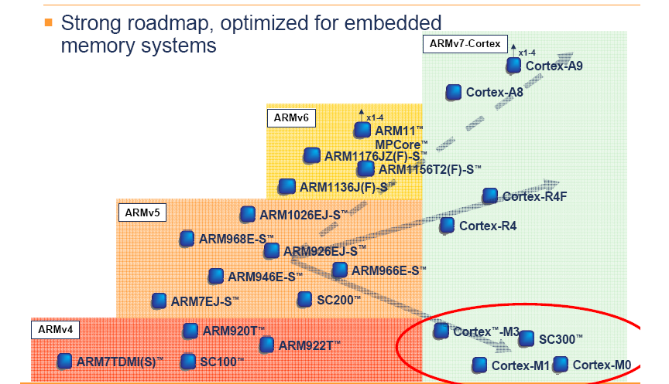
ARM architecture road map
Reference from ARM

Slide 3
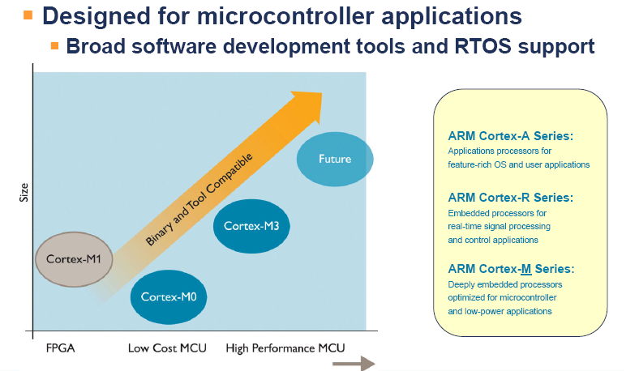
Cortex-M processor roadmap
Reference from ARM

Slide 4
Cortex-M0 性能
Reference from ARM

Slide 5
Cortex-M0 Function Block
Cortex-M0 处理器包括
  Cortex-M0 内核
  Nested Vectored Interrupt Controller (NVIC)
  System Timer (SysTick)
ROM
RAM
Peripherals
Nested
Vectored
Interrupt
Controller
(NVIC)
Cortex-M0
Processor
core
AHB-Lite
interface
Interrupts
System Timer
(SysTick)
Cortex-M0

Slide 6
Cortex-M0 Architecture Overview
ARMv6-M (ARMv7-M的子集, 向上兼容)
  只支持Thumb 指令集. 不需要Interworking 代码.
  总共56 条指令. 6 条是32-bit 长, 其余的都是16-bit 长
    32-bit 指令: BL, DMB, DSB, ISB, MRS, MSR
支持byte (8-bit), halfword (16-bit) and word (32-bit) 数据类型, 数据访问时地址必须对1/2/4齐.

Slide 7
Cortex-M0 Architecture Overview – cont.
处理器包含两种模式：Thread 和Handler.
  Always in privilege
  支持硬件上下文切换(进出ISR不需要汇编代码).
内嵌timer 和中断处理器
  NVIC, Systick
Memory mapped I/O
  Use same instructions to access memory and registers
  Ex : LDR, STR

Slide 8
内存模型
32-bit 寻址空间
ARMv6-M不支持虚拟地址.
取指令总是halfword-aligned
数据访问总是地址对齐的
  Ex : word at address A : A, A+1, A+2 and A+3.

Slide 9
异常模型
异常可以是中断或者 hardware error
每个异常有exception number, 优先级和向量地址
  Vector address
  Vector table base address is fixed at 0x00000000
Word 0
Initial value of stack
0x00000000
Word 1
Vector address of exception 1
Word 2
Vector address of exception 2
Word 47
Vector address of exception 47
Vector Table

Slide 10
Exception Model – cont.
Exceptions defined in Cortex-M0
Exception number | Exception | Priority level
1 | Reset | -3
2 | NMI | -2
3 | HardFault | -1
11 | SVCall | configured by register SHPR2
14 | PendSV | configured by register SHPR3
15 | SysTick | configured by register SHPR3
16 | External Interrupt (0) | configured by register NVIC_IPRx
… | … | …
47 | External Interrupt (31) | configured by register NVIC_IPRx

Slide 11
Exception Model – cont.
Exception priorities and pre-emption
  Lower numbers take higher precedence
  If multiple exceptions have the same priority number, the pending exception with the lowest exception number takes precedence.
  Only exceptions with a higher priority (lower priority number) can pre-empt an active exception.

Slide 12
Context Saving and Restoring
Key context saving and restoring
  Using full-descending stack format (decremented immediately before storing, incremented after reading)
  xPSR, ReturnAddress(), LR (R14), R12, R3, R2, R1, and R0
SP’
H
xPSR
ReturnAddress
Loaded into PC on exception return
LR
r12
r3
r2
r1
SP
r0
L

Slide 13
Cortex-M0 地址映射
Code
Typically ROM or flash memory, WT
0x00000000 – 0x1FFFFFFF
0x20000000 – 0x3FFFFFFF
SRAM
Typically used for on-chip RAM, WBWA
0x40000000 – 0x5FFFFFFF
Peripheral
on-chip peripheral, XN
0x60000000 – 0x7FFFFFFF
0x80000000 – 0x9FFFFFFF
0xA0000000 – 0xBFFFFFFF
0xC0000000 – 0xDFFFFFFF
System
system segment including the PPB, XN
0xE0000000 – 0xFFFFFFFF
Note 1 : Event entry points (vectors), system control, and configuration are defined at physical addresses
Note 2 : A multi-word access which crosses a 0.5GB address boundary is UNPREDICTABLE

Slide 14
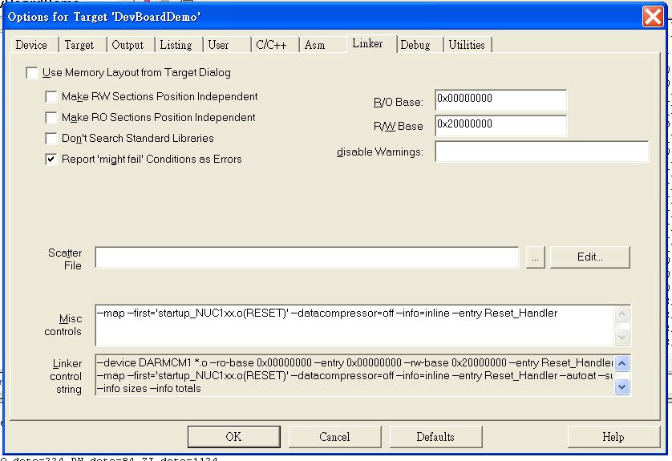
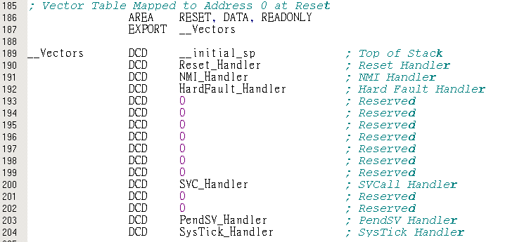
Setting in Keil
Code region
SRAM region
Program entry point

Slide 15
System Control Space (SCS)
Consists of the following groups
  CPUID space.
  System control, configuration and status.
  SysTick system timer
  Nested Vectored Interrupt Controller (NVIC)
0xE000E000 - 0xE000E00F
Auxiliary Control register
0xE000E010 - 0xE000E0FF
System Timer
0xE000E100 - 0xE000ECFF
NVIC
0xE000ED00 - 0xE000ED8F
System control and ID registers
0xE000EDF0 - 0xE000EEFF
Debug control and configuration

Slide 16
System Control Space – cont.
System control and ID register
Address | Name | Function | Type | Reset Value
0xE000E008 | ACTLR | Auxiliary Control Register | R/W | IMPLEMENTATION DEFINED
0xE000ED00 | CPUID | CPUID Register | RO | IMPLEMENTATION DEFINED
0xE000ED04 | ICSR | Interrupt Control State Register | R/W | 0x00000000
0xE000ED08 | VTOR | Vector Table Offset Register | RO | 0x00000000
0xE000ED0C | AIRCR | Application Interrupt/Reset Control Register | R/W | bits [10:8] = ’000’
0xE000ED10 | SCR | System Control Register (optional) | R/W | bits [4,2,1] = ’000’
0xE000ED14 | CCR | Configuration and Control Register | RO | bits [9,3] = ’1’
0xE000ED1C | SHPR2 | System Handler Priority Register 2 | R/W | SBZ
0xE000ED20 | SHPR3 | System Handler Priority Register 3 | R/W | SBZ
0xE000ED24 | SHCSR | System Handler Control and State Register | R/W | 0x00000000
0xE000ED30 | DFSR | DebugFault Status Register (Debug Extension only) | R/W | 0x00000000

Slide 17
System Control Space – cont.
Some registers are implementation defined and read-only
  Ex : CPUID, VTOR
Interrupt Control State Register (ICSR)
  Generate system interrupt request in software manner.
  NMI, PendSV and SysTick
System Handler Priority Registers
  Set up priority number of system interrupts
    SHPR2 : SVCall
    SHPR3 : SysTick and PendSV

Slide 18
System timer - SysTick
SysTick provides a simple, 24-bit 写清0, 递减, 周期性的计数器.
When enabled, the timer will count down. When the counter transitions to zero, the COUNTFLAG status bit is set.
The reference clock can be the core clock or an external clock source.
SysTick request
when counter
reaches 0
CPU clock
Reference
clock
24-bit
down count counter
external clock
Reload counter

Slide 19
System timer – cont.
System timer register
Address | Name | Function | Type | Reset Value
0xE000E010 | SYST_CSR | SysTick Control and Status | R/W | 0x00000000
0xE000E014 | SYST_RVR | SysTick Reload value | R/W | UNKNOWN
0xE000E018 | SYST_CVR | SysTick Current value | R/W | UNKNOWN
0xE000E01C | SYST_CALIB | SysTick Calibration value | RO | IMP DEF

Slide 20
System timer – cont.
SysTick Control and Status (SYST_CSR)
  Enables counting and interrupt
  Selects reference clock source
SysTick Reload value (SYST_RVR)
  Copied to current value register when counter reaches 0
SysTick Current value (SYST_CVR)
  Keeps current counter value
SysTick Calibration value (SYST_CALIB)
  Defined by implementation

Slide 21
NVIC (Nested Vectored Interrupt Controller)
Upon stack based exception model
  Restore registers to resume to normal execution automatically
  Remove redundant PUSH/POP operations needed by traditional C-based ISRs.
Benefits over traditional systems
  Enhancing performance in low MHz systems
  Provide deterministic response for late arrival and pre-emption
  Achieve lower latency without state restore and save
21
Notes:
21

Slide 22
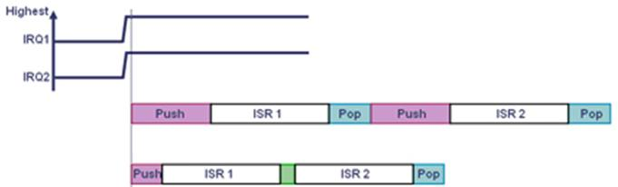
Tail Chaining Technology
The processor state is automatically saved on interrupt entry, and restored on interrupt exit
Fewer cycles than a software implementation, significantly enhancing performance in low MHz systems
Traditional MCU
NuMicro
22

Slide 23
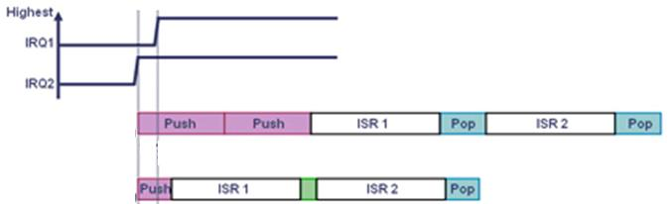
Late Arrival of Higher Priority Interrupts
NVIC immediately fetches a new vector address to service the pending interrupt
Provide deterministic response to these possibilities with support for late arrival and pre-emption
Traditional MCU
NuMicro
23

Slide 24
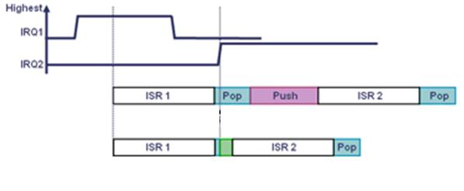
Stack Pop Pre-emption
Abandon a stack Pop if an exception arrives and service the new interrupt immediately.
Achieve lower latency in a deterministic manner by pre-empting and switching to the second interrupt without completing the state restore and save
Traditional MCU
NuMicro
24

Slide 25
Nested Vectored Interrupt Controller (NVIC)
最多32 (IRQ[31:0]) 个中断，支持level-sensitive or pulse-sensitive.
NVIC interrupts can be enabled/disabled, pended/un-pended and prioritized by setting NVIC control registers
interrupt 0
:
Interrupt 31
NVIC
Interrupt
number
Exception
number
Exception 1
Cortex-M0
Exception 2
Exception 47
System
interrupts
Vector Table

Slide 26
NVIC – cont.
NVIC registers
Address | Name | Function | Type | Reset Value
0xE000E100 | NVIC_ISER | Irq 0 to 31 Set-Enable Register | R/W | 0x00000000
0xE000E180 | NVIC_ICER | Irq 0 to 31 Clear-Enable Register | R/W | 0x00000000
0xE000E200 | NVIC_ISPR | Irq 0 to 31 Set-Pending Register | R/W | 0x00000000
0xE000E280 | NVIC_ICPR | Irq 0 to 31 Clear-Pending Register | R/W | 0x00000000
0xE000E400 | NVIC_IPR0 | Irq 0 to 3 Priority Register | R/W | 0x00000000
0xE000E404 | NVIC_IPR1 | Irq 4 to 7 Priority Register | R/W | 0x00000000
0xE000E408 | NVIC_IPR2 | Irq 8 to 11 Priority Register | R/W | 0x00000000
0xE000E40C | NVIC_IPR3 | Irq 12 to 15 Priority Register | R/W | 0x00000000
0xE000E410 | NVIC_IPR4 | Irq 16 to 19 Priority Register | R/W | 0x00000000
0xE000E414 | NVIC_IPR5 | Irq 20 to 23 Priority Register | R/W | 0x00000000
0xE000E418 | NVIC_IPR6 | Irq 24 to 27 Priority Register | R/W | 0x00000000
0xE000E41C | NVIC_IPR7 | Irq 28 to 31 Priority Register | R/W | 0x00000000

Slide 27
NVIC – cont.
Interrupt Set-Enable and Clear-Enable Registers
  NVIC_ISER : write 1 to enable interrupt
  NVIC_ICER : write 1 to disable interrupt
Interrupt Set-Pending and Clear-Pending Registers
  NVIC_ISPR : write 1 to generate interrupt request
  NVIC_ICPR : write 1 to remove interrupt request
Interrupt Priority Registers
  NVIC_IPR0 ~ NVIC_IPR7
  Each priority register can set up priority number of four interrupts

Slide 28
总结
Cortex-M0 总是在privileged 模式，只支持Thumb 指令.
支持硬件上下文切换
  xPSR, return address, r14, r12, r3, r2, r1, r0
系统地址映射是预先定义的.
  Code, SRAM, Peripheral, System
包含SysTick and NVIC
Cortex-M0 functional blocks

Slide 29
Thanks

