Slide 1
NuMicro
Architecture, System, Tools, CMSIS
NuMicro@nuvoton.com
Notes:
Good afternoon, everybody. My name is Jason Tu, The purpose of my presentation is to introduce our NUC100 series architecture, system & what tools are available. Finally, I will introduce “what is CMSIS” If you have any questions, I’ll be happy to answer you as we go along.

Slide 2
内容
方块图
系统内存映射
电源管理
复位源
时钟控制
中断
CMSIS
Notes:
I will introduce the block diagram & what is ISP ICP System Me

Slide 3
产品定位
NUC150/NUC170^{*2}
Cortex-M0
Up to 512KB Flash ROM
Up to 64KB SRAM
1x12-bit
ADC
Ethernet
MAC
Motor
PWM
UART
NUC140 Connectivity Line
Up to 128KB Flash ROM
Up to 16KB SRAM
CAN
LIN
USB
SPI
I²C
NUC130 Automotive Line
I²S
^{＊1}
Up to 128KB Flash ROM
Up to 16KB SRAM
CAN
LIN
8-channel PWM
NUC120 USB Line
NUC122/NUC123
Up to 68KB Flash
20KB RAM
12-bit ADC
Up to 128KB Flash ROM
Up to 16KB SRAM
USB
Comparators
NUC100 Advance Line
32-bit Timers
Up to 128KB Flash ROM
Up to 16KB SRAM
Watchdog
M051 Base Line
Internal 22MHz RC
Up to 64KB Flash ROM
Up to 4KB SRAM
Real Time Clock
^{＊1}
Mini51 Mini Line
DMA
^{＊1}
^{＊1} : Denoted without supported
in M051 or Mini51 series
^{*2} : Developing
GPIO
Up to 16KB Flash ROM
Up to 2KB SRAM

Slide 4
Product Positioning
Future products with higher density and more functionalities
Cortex-M0
42MHz
Up to 256KB Flash ROM
Up to 32KB SRAM
16/24-bit
ADC
OPAMP
UART (x5)
Nano130 LCD + USB Advanced Line
SPI (x3)
Up to 128KB Flash ROM
Up to 16KB SRAM
Touch
Key x16
USB
LCD
4x40,6x38
I²C (x2)
Nano120 USB Line
I²S
Up to 128KB Flash ROM
Up to 16KB SRAM
Touch
Key x16
USB
PWM (x8)
Smart Card (x3)
( ISO7816-3)
Nano110 LCD Line
Up to 128KB Flash ROM
Up to 16KB SRAM
Touch
Key x16
LCD
4x40,6x38
12-bit ADC (x12)
12-bit DAC (x2)
Nano100 Base Line
32-bit Timers
Up to 128KB Flash ROM
Up to 16KB SRAM
Touch Key x16
Watchdog
Ultra Low Power Consumption
12MHz +/-0.25% RC OSC
10KHz RC OSC
Single Power Supply : Operating Voltage @ 1.8V ~ 3.6V
Normal mode : 200uA / MHz @ CPU runs 12MHz, 3.3V
Idle mode : 75uA / MHz @ 12MHz, CPU stop, 3.3V
Power down mode : CPU and all clocks stop, RAM retention.
- 2..0uA @ 32.768KHz RTC turn on
- 0.8uA @ 32.768KHz RTC turn off
Wake up time from power down mode : < 7us
Real Time Clock
PDMA
GPIO
Notes:
4

Slide 5
NuMicro 家族
NUC 100 series IC 内嵌 Cortex –M0 核(Up to 50Mhz)
  32K/64K/128KB Flash memory for program memory (APROM)
  Configurable data flash address and size for 128kB system, fixed 4kB data flash for the 32kB and 64kB system
  4kB flash for ISP loader
  4K/8K/16K embedded SRAM
M051 series IC 内嵌 Cortex-M0 核(Up to 50Mhz)
  8KB/16KB/32KB/64KB Flash memory for program memory (APROM)
  4KB Flash memory for data memory (DataFlash)
  4KB Flash memory for loader (LDROM)
  4KB SRAM for internal scratch-pad RAM (SRAM)
Mini51 series IC 内嵌 Cortex-M0 核 (Up to 24Mhz)
  4KB/8KB/16KB Flash memory for program memory (APROM)
  Configurable Flash memory for data memory (Data Flash)
  2KB Flash memory for loader (LDROM)
  2KB SRAM for internal scratch-pad RAM (SRAM)
宽电压：2.5V to 5.5V
Notes:
I just talked about that NUC100 series embed ARM Cortex-M0 CPU core, And it’s working frequency can be up to 50 MHZ. For our embeded application program flash , it has 32K or 64K or 128 K bytes selection for different part No. For the data flash part, if you choose 64K or 32K part no, The data flash is 4K Bytes. And if you choose 128KB, you can set the data flash by coonfig register.
For the RAM part, it had 4KB/8K/16KB selection for different part NO.
OK Let me see how to program the flash code, For our IC, we offered 3 methods to program your code, One is ISP, its interface is UARR or USB , another is ICP and it’s interface is 2 wire SWD, For next 2 slides, I will introduce “What is ISP” “What is ICP” , The final method for programming the code , we can use the parallel flash writer to update the code,
For ICE debug part, we support 2 wire Serial Debug Interface.
Well, Let me see our IC working voltage, it can be from 2.5 Volt to 5.5 Volt

Slide 6
NuMicro 家族
Nano series IC 内嵌 Cortex-M0 核(Up to 42Mhz)
  32KB/64KB/123KB Flash memory for program memory (APROM)
  Configurable Flash memory for data memory (Data Flash)
  4KB Flash memory for loader (LDROM)
  8KB/16KB SRAM for internal scratch-pad RAM (SRAM)
宽电压：1.8V to 3.6V
Support ISP (In System Programming) by USB or UART
Support 2 wire ICP ( In Circuit Programming) update from ICE interface
Support fast parallel programming mode by external writer
2 wire SWD ICE interface
Notes:
I just talked about that NUC100 series embed ARM Cortex-M0 CPU core, And it’s working frequency can be up to 50 MHZ. For our embeded application program flash , it has 32K or 64K or 128 K bytes selection for different part No. For the data flash part, if you choose 64K or 32K part no, The data flash is 4K Bytes. And if you choose 128KB, you can set the data flash by coonfig register.
For the RAM part, it had 4KB/8K/16KB selection for different part NO.
OK Let me see how to program the flash code, For our IC, we offered 3 methods to program your code, One is ISP, its interface is UARR or USB , another is ICP and it’s interface is 2 wire SWD, For next 2 slides, I will introduce “What is ISP” “What is ICP” , The final method for programming the code , we can use the parallel flash writer to update the code,
For ICE debug part, we support 2 wire Serial Debug Interface.
Well, Let me see our IC working voltage, it can be from 2.5 Volt to 5.5 Volt

Slide 7
ARM Cortex-M0 Function Block Diagram
4 Break Point
2 Watchpoint
Notes:
The CPU processor is ARM Cortex-M0.
It has Wakeup Interrupt controller for power-management using. And it has NVIC interrupt controller. The NVIC can handle some tasks when interrupt happens. For the ICE debug interfacwe, it use 2 wire Serial Wire Debug Port interface to debug the CPU core register & peripheral registers. And it just supports 4 break point and 2 watch point.

Slide 8
System Memory Map
0xE000_EFFF
Cortex M0 System Register
System
0xE000_E000
Reserved
0x501F_FFFF
AHB peripherals
0x5000_0000
Reserved
Peripheral
0x401F_FFFF
APB peripherals
0x4000_0000
Reserved
0x2000_3FFF
16KB RAM
SRAM
0x2000_0000
Reserved
0x0010_0FFF
ISP Loader Program Memory (4KB LDROM)
0x0010_0000
Code
Reserved
0x0001_EBFF
Application Program Memory (123KB APROM)
0x0000_0000
Notes:
For the previous Cortex-M0 introduction, it had told you that ARM had defined the relative memory map for Flash, RAM, peripherals. Well, for our NUC100 series, it also defines the relative address. For the AP address is from 0x0000_0000 to 0x001_FFFF, And the LD address is from 0x0010_0000 to 0x0010_00FF. And the APB peripherals is from 0x4000_0000 to 0x401F_FFFF

Slide 9
电源管理(1/2)
Normal Run Mode
  Flexible system clock source selection
  All peripherals clock can be turned off individually.
Sleep Mode (IDLE Mode)
  CPU halt, peripheral is probably under running which depends on your application
Deep Sleep Mode (Power Down Mode)
  CPU & peripheral are all halt
Notes:
Well, Let’s change to the topic for the Power management. For the NUC100 series, it had 3 running modes. The first is Normal RUN mode, On this mode, the CPU is normal running. But for the CPU clock source, you can select High frequency like PLL out 50 MHZ or Low frequency like internal 10K Hz. So the clock setting is very flexible. For the peripherals clock, it also can turn on or turn off depends on your application.
The second mod is Sleep Mode, Someone also called it IDLE mode. In this mode, The CPU is stop. And the peripherals can turn on or turn off by your application.
The final is Deep sleep mode, Someone call it Power Down mode, In this mode, CPU & peripherals are all in halt state.

Slide 10
Power Management (2/2)
Sleep mode
Deep Sleep mode
UNLOCKREG();
CLK->PWRCTL &= ~CLK_PWRCTL_PWRDOWN_EN;
LOCKREG();
__WFI();
UNLOCKREG();
CLK->PWRCTL |= CLK_PWRCTL_PWRDOWN_EN | CLK_PWRCTL_DELY_EN;
SCB->SCR |= 0x04;
LOCKREG();
__WFI();

Slide 11
System Reset
Hardware Reset
  The Power-On Reset
  /RESET pin Reset
  Watchdog Time Out Reset
  Low Voltage Detected Reset
  Brown-Out-Detected Reset
Software Reset
  CPU_RST
    To write 1 to the CPU_RST( IPRSTC1[1],”IP Reset Source Register”) register
    Just only reset CPU & flash controller
  CHIP_RST
    To write 1 to CHIP_RST( IPRSTC1[0], IP Reset Source Register) register
    To reset the whole chip like “Power-on reset”
  MCU_RST
    Write 1 to the SYSRESETREQ (AIRCR[2], Application Interrupt & Reset Control Register”)
    To reset the whole chip
“RSTSRC” register identify chip’s reset source from last operation
Notes:
For the System reset, In this slide, we will tell you about the reset source. Firstly, we look at the hardware reset part, it has 5 hardware reset sources. The Power-On Reset. When you turn on the power, the internal POR circuit will generate the reset signal to whole chip. The next is /RESET pin had low level signal to reset the whole chip.
Watch Time Out Reset, The internal watchdog timer time out reset.
Low Voltage detected reset: When the power is down to therehold voltage, it also can generate the reset.
Brown Detected Reset: It had 4 voltage selection to reset whole chip
For the software reset, you can write some register to reset the chip.
CPU_RST, To write 1 to the IPRSTC[1], But this action just reset CPU & Flash
Or you can write 1 to this register. And this reset action can reset the whole chip, like “Power-On Reset”
For the whole chip reset you can also write to this Cortex-M0 System register, it also can reset whole chip
If you want check what reset make the chip reset, you can read the RSTSTRC register to check

Slide 12
RSTSRC (System Reset Source Register)
Register | Address | R/W | Description | Reset Value
RSTSRC | 0x5000_0004 | R/W | System Reset Source Register | 0x0000_00xx
These bits are cleared by writing 1 to itself
7 | 6 | 5 | 4 | 3 | 2 | 1 | 0
RSTS_CPU | Reserved | RSTS_MCU | RSTS_BOD | Reserved | RSTS_WDG | RSTS_PAD | RSTS_POR
CPU_RST
Power-on reset
/RESET Pin Reset
MCU_RST
Watchdog Reset
Brown Out Reset
Notes:
If you want to check what reset source to reset the chip, you can read this RSTRC register to check the reset source. If the bit0 is 1, it shows that it had power on reset condition, it the bit1 is 1, it shows that the reset pin had low level signal change. And the bit 2 shows that it is watchdog reset.

Slide 13
System Reset Source Table List
Reset Status Reset Source | 7 | 6 | 5 | 4 | 3 | 2 | 1 | 0
 | RSTS_CPU | Reserved | RSTS_MCU | RSTS_BOD | Reserved | RSTS_WDG | RSTS_PAD | RSTS_POR
Power-On Reset | 0 | x | 0 | 0 | 0 | 0 | 1 | 1
Reset Pin Reset | 0 | x | 0 | 0 | 0 | 0 | 1 | 0
Watchdog Time Out Reset | 0 | X | 0 | 0 | 0 | 1 | 0 | 0
Brown-Out Reset | 0 | X | 0 | 1 | 0 | 0 | 0 | 0
Cortex-M0 MCU Reset | 0 | X | 1 | 0 | 0 | 0 | 0 | 0
CHIP_RST | 0 | X | 0 | 0 | 0 | 0 | 0 | 1
CPU_RST | 1 | X | 0 | 0 | 0 | 0 | 0 | 0
Notes:
This is table list for different reset condition. And you can see it has the “power-on Reset”, the bit0 & bit1 will be set. May be , you will have a question, why the bit1 also become 1. Because when you turn on the power, the reset pin also have level change. So this bit will also be set when you turn on the power.
OK, Let’s keep on checking the other reset condition, If just only the reset pin reset, the bit1 will be set. If it is watch dog reset, the bit 2 will be set.
Let’s check the software CHIP_RST, it just only the bit1 will be set.

Slide 14
Peripheral IP Reset
Every peripheral has corresponded reset register
“IPRST_CTL1” & “IPRST_CTL2” register had defined the corresponded peripheral asynchronous reset signal
Notes:
For the NUC100 series, every peripheral had it’s reset register. These peripheral resets register are all located on the IPRST1 & IPRSTC2 register.

Slide 15
IPRST_CTL2 (IP Reset Control Register 2)
Register | Offset | R/W | Description | Reset Value
IPRST_CTL2 | 0x5000_000C | R/W | IP Reset Control Resister 2 | 0x0000_0000
31 | 30 | 29 | 28 | 27 | 26 | 25 | 24
SC1_RST | SC0_RST | I2S_RST | ADC_RST | USBD_RST | LCD_RST | DAC_RST | TK_RST
23 | 22 | 21 | 20 | 19 | 18 | 17 | 16
Reserved | Reserved | PWM1_RST | PWM0_RST | Reserved | Reserved | UART1_RST | UART0_RST
15 | 14 | 13 | 12 | 11 | 10 | 9 | 8
Reserved | SPI2_RST | SPI1_RST | SPI0_RST | Reserved | Reserved | I2C1_RST | I2C0_RST
7 | 6 | 5 | 4 | 3 | 2 | 1 | 0
SC1_RST | Reserved | TMR3_RST | TMR2_RST | TMR1_RST | TMR0_RST | GPIO_RST | Reserved
Set these bit “1” will generate synchronous reset signal to the correspond IP.
User need to set bit to “0” to release IP from the reset state
Notes:
The slide is IPSRTC2 perpherial reset register description, you can set the bit to reset GPIO or you can set this bit to reset Timer0, or you can set the bit to rest UART1. If you want to release the reset state, you just clear these bit.

Slide 16
时钟控制
时钟源控制
  PWRCTL : Enable/Disable LIRC, HIRC, LXT and HXT output.
  PLLCTL : Enable/Disable PLL output.
  CLKSTATUS : Reports clock status.
IP 时钟控制
  AHBCLK, APBCLK : Enable/Disable individual IP clock.
  CLKSEL0, CLKSEL1, CLKSEL2 : Select IP clock source.
  CLKDIV0, CLKDIV1 : Set IP clock divider.
时钟监控
  TESTCLK : Output clock (including clock sources and IP clock) to pin PC.0.

Slide 17
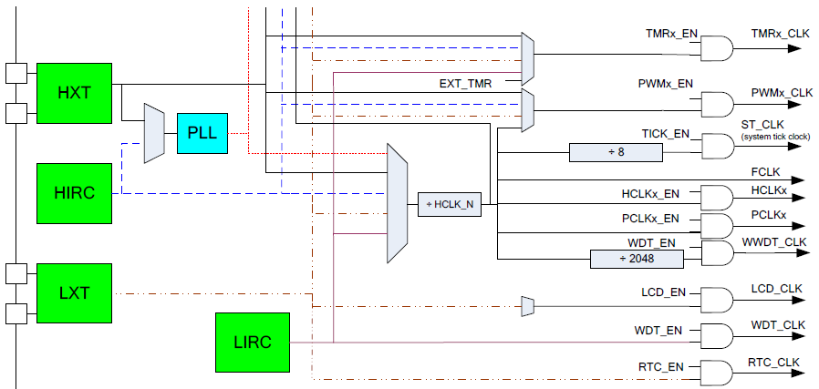
时钟系统

Slide 18
HIRC TRIM
Trim HIRC to 11.0592MHz, 12MHz or 12.288MHz according to 32K (LXT).
IRCTRIMCTL :
  [1:0] TRIM_SEL : Will be cleared once error or time-out occurs. Software need to set and start auto-trim again.

Slide 19
HIRC TRIM
IRCTRIMIEN : Enable/Disable trim failure interrupt.
IRCTRIMINT : Report the trim result.
19

Slide 20
NuMicro NVIC
NVIC (Nested Vectored Interrupt Controller)
  An integrated part of the Cortex-M0 processor
  It supports 32 peripheral interrupts input
  it supports NMI( Nonmaskable Interrupt) input
  It supports “Tail Chaining” & “Late Arrival”
Interrupt handler follows the CMSIS coding rule
Notes:
The NVIC is nested vectored interrupt controller. And the NVIC is an integrated part of the Cortex-M0 processor. It can support 32 interrupt input and 1 Nonmaskable interrupt. And for reducing latency, it also supports the “Tail Chaining” & Late Arrival function.
For the interrupt handler service routine, it follows the CMSIS coding rule

Slide 21
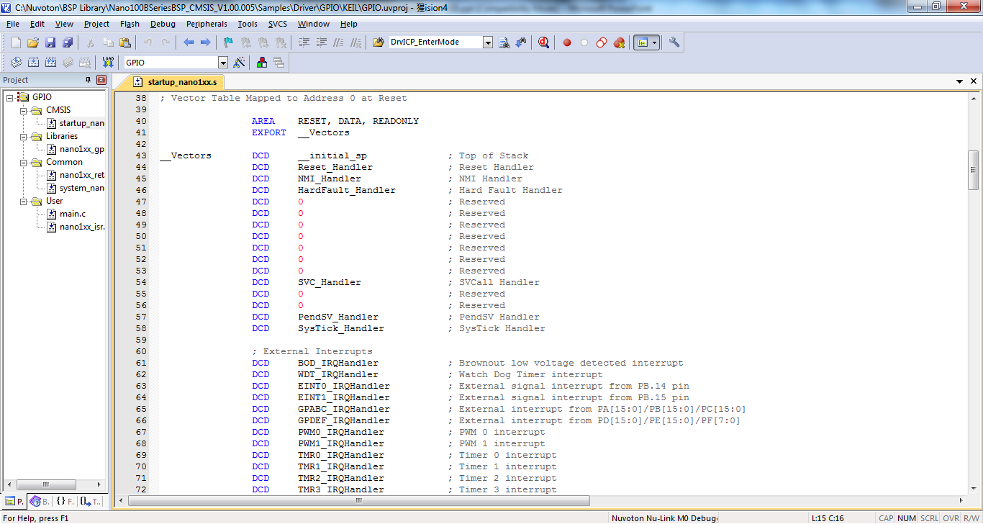
C ISR Function Call Name
In “startup_nano1xx.s” vector table address save peripherals ISR function address
Notes:
In the file,statup_NUC1xx.s file, we had write down the peripherals ISR function address in the vector table. You can see the BOD_IRQHandler, WDT_IRQHandler and so on.

Slide 22
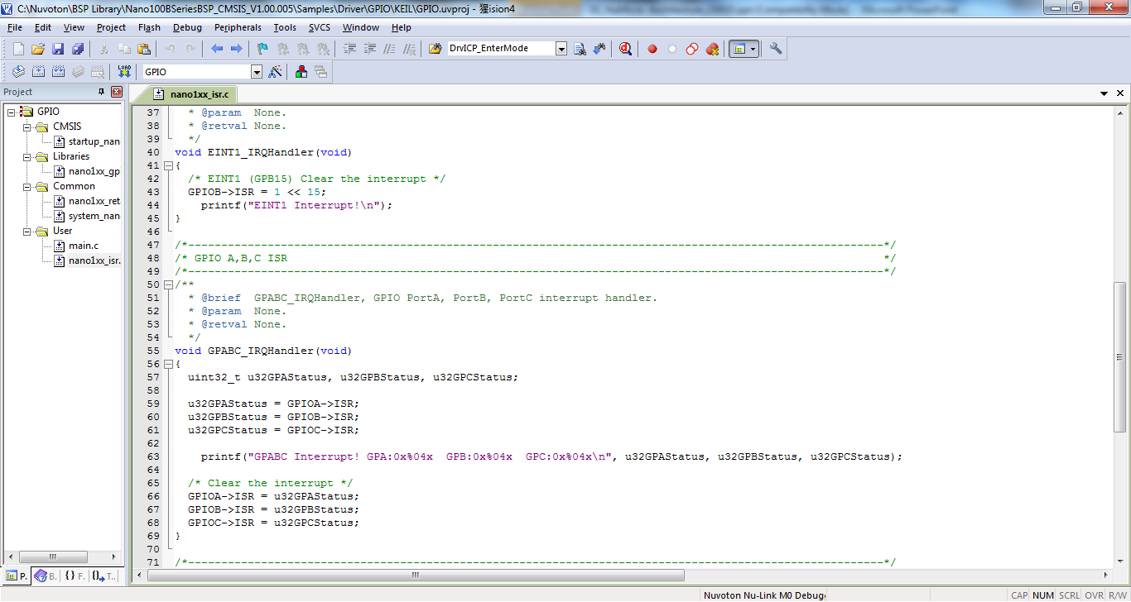
ISR Handler
Notes:
So for the customer they just write the peripheral handler on their C code. Like this TMR0_IRQHandler. When the timer0 nterrupt happens, the Cortex-M0 will jump to timer0 vector table to fetch the ISR address and jump to the address to excute.

Slide 23
System Peripheral Interrupt Map (16~32)
Vector Number | Interrupt Number (Bit in Interrupt Registers) | Interrupt Name | Source IP | Interrupt description
0 ~ 15 | - | - | - | System exceptions
16 | 0 | BOD_OUT | Brown-Out | Brownout low voltage detected interrupt
17 | 1 | WDT_INT | WDT | Watch Dog Timer interrupt
18 | 2 | EINT0 | GPIO | External signal interrupt from PB.14 pin
19 | 3 | EINT1 | GPIO | External signal interrupt from PB.15 pin
20 | 4 | GPABC_INT | GPIO | External interrupt from PA[15:0]/PB[13:0]/PC[15:0]
21 | 5 | GPDEF_INT | GPIO | External interrupt from] PD[15:0]/PE[15:0]/PF[15:0]
22 | 6 | PWM0_INT | PWM0 | PWM0 interrupt
23 | 7 | PWM1_INT | PWM1 | PWM1 interrupt
24 | 8 | TMR0_INT | TMR0 | Timer 0 interrupt
25 | 9 | TMR1_INT | TMR1 | Timer 1 interrupt
26 | 10 | TMR2_INT | TMR2 | Timer 2 interrupt
27 | 11 | TMR3_INT | TMR3 | Timer 3 interrupt
28 | 12 | UART0_INT | UART0 | UART0 interrupt
29 | 13 | UART1_INT | UART1 | UART1 interrupt
30 | 14 | SPI0_INT | SPI0 | SPI0 interrupt
31 | 15 | SPI1_INT | SPI1 | SPI1 interrupt
32 | 16 | SPI2_INT | SPI2 | SPI2 interrupt

Slide 24
System Peripheral Interrupt Map (33~47)
Vector Number | Interrupt Number (Bit in Interrupt Registers) | Interrupt Name | Source IP | Interrupt description
33 | 17 | IRC_INT | IRC | IRC TRIM interrupt
34 | 18 | I2C0_INT | I2C0 | I2C0 interrupt
35 | 19 | I2C1_INT | I2C1 | I2C1 interrupt
36 | 20 | SC2_INT | SC2 | Smart Card2 interrupt
37 | 21 | SC0_INT | SC0 | Smart Card0 interrupt
38 | 22 | SC1_INT | SC1 | Smart Card1 interrupt
39 | 23 | USB_INT | USBD | USB FS Device interrupt
40 | 24 | TK_INT | TOUCH | Touch Key interrupt
41 | 25 | LCD_INT | LCD | LCD interrupt
42 | 26 | DMA_INT | DMA | DMA interrupt
43 | 27 | I2S_INT | I2S | I2S interrupt
44 | 28 | PD_WU_INT | CLKC | Clock controller interrupt for chip wake up from power-down state
45 | 29 | ADC_INT | ADC | ADC interrupt
46 | 30 | DAC_INT | DAC | DAC interrupt
47 | 31 | RTC_INT | RTC | Real time clock interrupt

Slide 25
General Purpose I/O Controller
GPIO type
  Input only with high impedance
  Push-Pull Output
  Open-Drain Output
Support Pull-Up Resistor
  110Kohm ~ 300kohm @1.8V~3.6V
Support GPIO interrupt for each I/O PIN
  Level trigger or Edge trigger

Slide 26
Input Mode
Just input mode
Output is tri-state ( high impedance) without drive capability

Slide 27
Push-Pull Output
CMOS Output

Slide 28
Open-Drain Output
Only with NMOS sink current capability

Slide 29
CMSIS
Cortex Microcontroller Software Interface Standard
ARM & Tool vendor (Keil, IAR..)
Structure
  Core Peripheral Access Layer (CPAL)
  Middleware Access Layer (MWAL) (ARM is current in development)
  Device Peripheral Access Layer (DPAL)
    Provide definitions for all device peripherals

Slide 30
CMSIS Directory Structure
CMSIS changes.htm
CMSIS debug support.htm
License.doc
CMSIS_V1P30
CM0
CoreSupport
core_cm0.c
core_cm0.h
ARMCM0.h
system_ARMCM0.c
system_ARMCM0.h
DeviceSupport
ARM
ARMCM0
startup
arm
startup_ARMCM0.s
gcc
iar
Example
arm
ARMCM0
main_ARMCM0.c
startup_ARMCM0.s
system_ARMCM0.c
iar
CM3
Sourcery G++Lite
Documentation
CMSIS_Core.htm
Notes:
This is CMSIS orginal directory structure, you

Slide 31
CMSIS Coding Rule
ANSI standard types defined in the ANSI C header file <stdint.h> are used
For each exception/interrupt
  An exception/interrupt handler rule
    exception: the postfix _Handler
    interrupts: the postfix _IRQHandler
  A # define of the interrupt number with postfix _IRQn
  A default exception/interrupt handler (weak definition) that contains an endless loop
Notes:
The data type follows the ANSI C “stdint.h”
For the exception handler it needs to add the postfix _Handler for relative exception
For the interrupt handler it needs to add the postfix _IRQHandler for relative interrupt handler

Slide 32
What CMSIS Files Do You Need For NUC100 Series?
nano1xx.h(device.h)
  Interrupt Number Definition
  Device Peripheral Access Layer
    Provides definitions for all device peripherals. It contains all data structures and the address mapping for the device specific peripherals
  To define the peripherals for the actual device. It can use several other include files to define the peripherals of the actual devices
startup_nano1xx.s(startup_device.s)
  Cortex-M0 startup code and the complete Interrupt Vector Table
system_nanoxx.c(system_device.c)
core_cm0.h
core_cm0.c
IC Vendor Offer 3files
ARM offer 2 files

Slide 33
NUC100 中断号
typedef enum IRQn
{
/****** Cortex-M0 Processor Exceptions Numbers **************************************************/
NonMaskableInt_IRQn = -14, /*!< 2 Non Maskable Interrupt */
HardFault_IRQn = -13, /*!< 3 Cortex-M0 Hard Fault Interrupt */
SVCall_IRQn = -5, /*!< 11 Cortex-M0 SV Call Interrupt */
PendSV_IRQn = -2, /*!< 14 Cortex-M0 Pend SV Interrupt */
SysTick_IRQn = -1, /*!< 15 Cortex-M0 System Tick Interrupt */
/****** NANO1xx Specific Interrupt Numbers ******************************************************/
BOD_IRQn = 0, /*!< Brownout low voltage detected interrupt */
WDT_IRQn = 1, /*!< Watch Dog Timer interrupt */
EINT0_IRQn = 2, /*!< External signal interrupt from PB.14 pin */
EINT1_IRQn = 3, /*!< External signal interrupt from PB.15 pin */
GPABC_IRQn = 4, /*!< External signal interrupt from PA[15:0]/PB[13:0]/PC[15:0] */
GPDEF_IRQn = 5, /*!< External interrupt from PD[15:0]/PE[15:0]/PF[15:0] */
PWM0_IRQn = 6, /*!< PWM 0 interrupt */
PWM1_IRQn = 7, /*!< PWM 1 interrupt */
TMR0_IRQn = 8, /*!< Timer 0 interrupt */
TMR1_IRQn = 9, /*!< Timer 1 interrupt */
:
:
:
I2C0_IRQn = 18, /*!< I2C0 interrupt */
I2C1_IRQn = 19, /*!< I2C1 interrupt */
SC2_IRQn = 20, /*!< Smart Card 2 interrupt */
SC0_IRQn = 21, /*!< Smart Card 0 interrupt */
SC1_IRQn = 22, /*!< Smart Card 1 interrupt */
USBD_IRQn = 23, /*!< USB FS Device interrupt */
TK_IRQn = 24, /*!< Touch key interrupt */
LCD_IRQn = 25, /*!< LCD interrupt */
PDMA_IRQn = 26, /*!< PDMA interrupt */
I2S_IRQn = 27, /*!< I2S interrupt */
PDWU_IRQn = 28, /*!< Power Down Wake up interrupt */
ADC_IRQn = 29, /*!< ADC interrupt */
DAC_IRQn = 30, /*!< DAC interrupt */
RTC_IRQn = 31 /*!< Real time clock interrupt */
} IRQn_Type;
中断号定义在“nano1xx.h” 文件中
Notes:
The related interrupt number we had listed in the “NUC1xx.h” file.

Slide 34
startup_NUC1xx.s (1/2)
_Vectors DCD __initial_sp ; Top of Stack
DCD Reset_Handler ; Reset Handler
DCD NMI_Handler ; NMI Handler
DCD HardFault_Handler ; Hard Fault Handler
DCD 0 ; Reserved
DCD 0 ; Reserved
DCD 0 ; Reserved
DCD 0 ; Reserved
DCD 0 ; Reserved
DCD 0 ; Reserved
DCD 0 ; Reserved
DCD SVC_Handler ; SVCall Handler
DCD 0 ; Reserved
DCD 0 ; Reserved
DCD PendSV_Handler ; PendSV Handler
DCD SysTick_Handler ; SysTick Handler
中断处理函数名字固定，定义在Cortex-M0的向量表中
Notes:
For the vector table, it needs to save the relative ISR function name. we also list it in the “sartup_NUC1xx.s

Slide 35
startup_NUC1xx.s (2/2)
;External Interrupts
DCD BOD_IRQHandler
DCD WDT_IRQHandler
DCD EINT0_IRQHandler
DCD EINT1_IRQHandler
DCD GPABC_IRQHandler
DCD GPDEF_IRQHandler
DCD PWM0_IRQHandler
DCD PWM1_IRQHandler
DCD TMR0_IRQHandler
DCD TMR1_IRQHandler
DCD TMR2_IRQHandler
DCD TMR3_IRQHandler
:
:
:
DCD SC2_IRQHandler
DCD SC0_IRQHandler
DCD SC1_IRQHandler
DCD USBD_IRQHandler
DCD TK_IRQHandler
DCD LCD_IRQHandler
DCD PDMA_IRQHandler
DCD I2S_IRQHandler
DCD PDWU_IRQHandler
DCD ADC_IRQHandler
DCD DAC_IRQHandler
DCD RTC_IRQHandler
中断处理函数名字固定，定义在Cortex-M0的向量表中

Slide 36
PWRCTL 寄存器
(Bit Field Definition)
31 | 30 | 29 | 28 | 27 | 26 | 25 | 24
RESERVED
23 | 22 | 21 | 20 | 19 | 18 | 17 | 16
RESERVED
15 | 14 | 13 | 12 | 11 | 10 | 9 | 8
 |  |  |  |  |  |  | PD_WAIT_CPU
7 | 6 | 5 | 4 | 3 | 2 | 1 | 0
PWR_DOWN | PD_WU_STS | WINT_EN | WU_DLY | OSC10K_EN | OSC22M_EN | XTL32K_EN | XTL12M_EN
/*---------------------------- Clock Controller ------------------------------*/
#define CLK_PWRCTL_HXT_EN ((uint32_t)0x00000001)
#define CLK_PWRCTL_LXT_EN ((uint32_t)0x00000002)
#define CLK_PWRCTL_HIRC_EN ((uint32_t)0x00000004)
#define CLK_PWRCTL_LIRC_EN ((uint32_t)0x00000008)
#define CLK_PWRCTL_DELY_EN ((uint32_t)0x00000010)
#define CLK_PWRCTL_WAKEINT_EN ((uint32_t)0x00000020)
#define CLK_PWRCTL_PWRDOWN_EN ((uint32_t)0x00000040)
#define CLK_PWRCTL_HXT_SELXT ((uint32_t)0x00000100)
#define CLK_PWRCTL_HXT_GAIN ((uint32_t)0x00000200)
#define CLK_PWRCTL_LXT_SCNT ((uint32_t)0x00000400)
Notes:
We use the structure to group the register like this, And you can set the

Slide 37
组织寄存器固定在CLK_BA BaseAddr (SYSCLK_T Data Type)
Register | Offset
PWRCTL | CLK_BA + 00
AHBCLK | CLK_BA + 04
APBCLK | CLK_BA + 08
CLKSTATUS | CLK_BA + 0C
CLKSEL0 | CLK_BA + 10
CLKSEL1 | CLK_BA + 14
CLKSEL2 | CLK_BA + 18
CLKDIV0 | CLK_BA+ 1C
CLKDIV1 | CLK_BA+ 20
PLLCTL | CLK_BA + 24
FRQDIV | GCR_BA + 28
WK_INTSTS | GCR_BA + 30
typedef struct
{
__IO uint32_t PWRCTL;
__IO uint32_t AHBCLK;
__IO uint32_t APBCLK;
__IO uint32_t CLKSTATUS;
__IO uint32_t CLKSEL0;
__IO uint32_t CLKSEL1;
__IO uint32_t CLKSEL2;
__IO uint32_t CLKDIV0;
__IO uint32_t CLKDIV1
__IO uint32_t PLLCTL;
__IO uint32_t FRQDIV;
__IO uint32_t TESTCLK;
__IO uint32_t WK_INTSTS;
} CLK_TypeDef;
Notes:
And the to group the relative register for using CLK_BA and generate a new structure type

Slide 38
To Access Register
#define AHBPERIPH_BASE 0x50000000
#define CLK_BASE (AHBPERIPH_BASE + 0x00200)
#define CLK ((CLK_TypeDef*) CLK_BASE)
AHB Modules Space (0x5000_0000 – 0x501F_FFFF)
0x5000_0000 – 0x5000_01FF | GCR_BA | System Global Control Registers
0x5000_0200 – 0x5000_02FF | CLK_BA | Clock Control Registers
0x5000_0300 – 0x5000_03FF | INT_BA | Interrupt Multiplexer Control Registers
0x5000_4000 – 0x5000_7FFF | GPIO_BA | GPIO Control Registers
0x5000_8000 – 0x5000_BFFF | PDMA_BA | SRAM_APB DMA Control Registers
0x5000_C000 – 0x5000_FFFF | FMC_BA | Flash Memory Control Registers
CLK -> PWRCTL |= CLK_PWRCTL_HXT_EN;
Notes:
Finallly to define the pointer address for the CLK_BA, and you can use the code to set the bit to 1

Slide 39
Cortex-M0 Core Registers Access (core_cm0.h)
Function Definition | Core Register | Description
void __enable_irq (void) | PRIMASK = 0 | Global Interrupt enable (using the instruction CPSIE i)
void __disable_irq (void) | PRIMASK = 1 | Global Interrupt disable (using the instruction CPSID i)
void __set_PRIMASK (uint32_t value) | PRIMASK = value | Assign value to Priority Mask Register (using the instruction MSR)
uint32_t __get_PRIMASK (void) | return PRIMASK | Return Priority Mask Register (using the instruction MRS)
void __set_CONTROL (uint32_t value) | CONTROL = value | Set CONTROL register value (using the instruction MSR)
uint32_t __get_CONTROL (void) | return CONTROL | Return Control Register Value (using the instruction MRS)
void __set_PSP (uint32_t TopOfProcStack) | PSP = TopOfProcStack | Set Process Stack Pointer value (using the instruction MSR)
uint32_t __get_PSP (void) | return PSP | Return Process Stack Pointer (using the instruction MRS)
void __set_MSP (uint32_t TopOfMainStack) | MSP = TopOfMainStack | Set Main Stack Pointer (using the instruction MSR)
uint32_t __get_MSP (void) | return MSP | Return Main Stack Pointer (using the instruction MRS)
Notes:
The CMSIS also offered some funciton name to access the Cortex-M0 core regiter. For example, if you want set” Globaol Interrupt Enable You can use the __enable_irq.

Slide 40
Cortex-M0 Instruction Access
Function Name | CPU Instruction | Description
void __WFI (void) | WFI | Wait for Interrupt
void __WFE (void) | WFE | Wait for Event
void __SEV (void) | SEV | Set Event
void __ISB (void) | ISB | Instruction Synchronization Barrier
void __DSB (void) | DSB | Data Synchronization Barrier
void __DMB (void) | DMB | Data Memory Barrier
uint32_t __REV (uint32_t value) | REV | Reverse byte order in integer value.
uint32_t __REV16 (uint16_t value) | REV16 | Reverse byte order in unsigned short value.
sint32_t __REVSH (sint16_t value) | REVSH | Reverse byte order in signed short value with sign extension to integer.
Notes:
For some instruction access, CMSIS also offer some function can use, for example, you can 40

Slide 41
NVIC Setup Function Call
Function Name | Parameter | Description
void NVIC_SetPriorityGrouping (uint32_t PriorityGroup) | Priority Grouping Value | Set the Priority Grouping (Groups . Subgroups)
void NVIC_EnableIRQ (IRQn_Type IRQn) | IRQ Number | Enable IRQn
void NVIC_DisableIRQ (IRQn_Type IRQn) | IRQ Number | Disable IRQn
uint32_t NVIC_GetPendingIRQ (IRQn_Type IRQn) | IRQ Number | Return 1 if IRQn is pending else 0
void NVIC_SetPendingIRQ (IRQn_Type IRQn) | IRQ Number | Set IRQn Pending
void NVIC_ClearPendingIRQ (IRQn_Type IRQn) | IRQ Number | Clear IRQn Pending Status
void NVIC_SetPriority (IRQn_Type IRQn, uint32_t priority) | IRQ Number, Priority | Set Priority for IRQn
uint32_t NVIC_GetPriority (IRQn_Type IRQn) | IRQ Number | Get Priority for IRQn
uint32_t NVIC_EncodePriority (uint32_t PriorityGroup, uint32_t PreemptPriority, uint32_t SubPriority) | IRQ Number, Priority Group, Preemptive Priority, Sub Priority | Encode priority for given group, preemptive and sub priority
NVIC_DecodePriority (uint32_t Priority, uint32_t PriorityGroup, uint32_t* pPreemptPriority, uint32_t* pSubPriority) | IRQ Number, Priority, pointer to Priority Group, pointer to Preemptive Priority, pointer to Sub Priority | Decode given priority to group, preemptive and sub priority
void NVIC_SystemReset (void) | (void) | Resets the System

Slide 42
Q&A
Thank You

