Slide 1
NuMicro Nano
I2C
NuMicro@nuvoton.com
Notes:
Good morning! We will introduce the I2C of Nu-Micro NUC100.

Slide 2
内容
描述
特性
协议
寄存器描述
应用
Notes:
We have a sample code to access EEPROM with I2C controller.

Slide 3
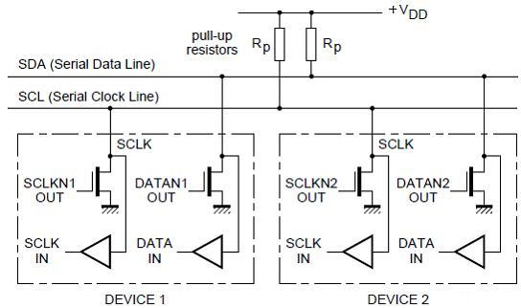
一般描述
2线双向总线, 由 SDA 和 SCL组成, 可以包含多个主和多个从设备
SDA 和SCL 都是双向的，开漏驱动，连接电阻上拉.
Notes:
1.I2C is a two-wired and bi-directional bus. It is comprised by SDA (Serial Data line) and SCL (Serial Clock Line).
2.Both SDA and SCL are Open-Drain driving type. They need to connect with pull-up resistors.

Slide 4
特性 (1/2)
最多支持2组I2C 控制器.
和Philips I2C 标准兼容.
支持主/从模式
支持7 bit 地址模式
内嵌一个 14-bit 超时计数器 避免 I2C 总线挂起.
支持唤醒功能(Power-down)

Slide 5
特性 (2/2)
多从地址识别( 2个从地址寄存器，2个掩码寄存器)
操作模式
  主发送
  主接收
  从发送
  从接收
  General call
Notes:
Feature.

Slide 6
I2C 协议
一般来说，一个标准的通讯过程分为4个阶段:
  START or Repeated START 信号
  发送从地址
  传输数据
  STOP 信号

Slide 7
START, Repeated START and STOP
总线空闲时, I2C 硬件通过发送START信号初始化一次传输.
主设备可以利用Repeated START 信号来继续传输，而不用释放总线.
主机通过发送STOP信号来结束传输.
Transmission starts with a START condition
Transmission ends with a STOP condition
Notes:
I2C enters master mode while START signal is detected by hardware.

Slide 8
从地址传输
主设备发送START信号之后第一个传输的字节就是从机地址.
从机地址由7-bit 从机地址 + R/W bit组成.
不可以有两个从设备有相同的地址
Mater transmits a 7-bit Slave address and 1-bit R/W
Notes:
After the successful slave address transfer, the data transfer can proceed on byte by byte basis.
The direction of data transfer is depended on R/W bit.

Slide 9
数据传输
从机地址成功传输之后，数据根据R/W bit指示的方向一个字节一个字节的传输.
传输的字节长度由应用自己指定
Data transfer stage
(example 1 byte data)
Notes:
The data length is based on actual application
The data length is one byte data in the figure,
Later, we will show an example. The data length is two bytes data in the sample code.

Slide 10
应答
Acknowledge
Position
NACK: High level
ACK: Low level
Each transferred byte is followed by an ACK or a NACK at 9th clock.
Notes:
ACK or NACK is present at 9th clock.

Slide 11
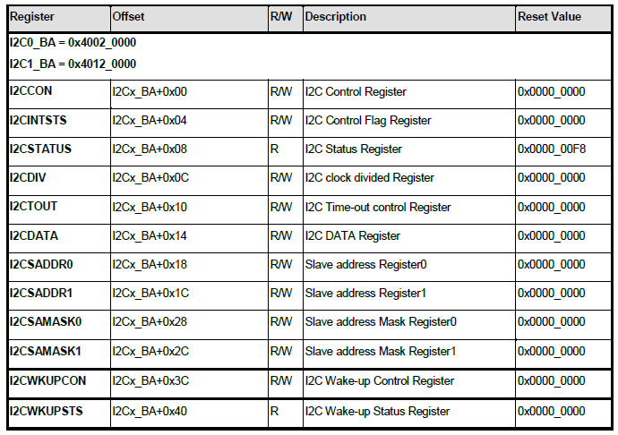
寄存器
Notes:
Register Description. 7 registers…

Slide 12
I2C 控制寄存器
7 | 6 | 5 | 4 | 3 | 2 | 1 | 0
INTEN | Reserved |  | I2C_STS | START | STOP | ACK | IPEN
I2C 使能
收到数据之后回复ACK
传输一个“STOP”信号.
由硬件自动清除.
传输一个·“START” “Repeat START” 信号
I2C STATUS 状态改变时, I2C_STS 被置，写”1”清0.
I2C 中断使能
Notes:
There are four control bits in this register. Include STA, STO, SI, and AA bit.
If AA=1, the I2C will return an ACK when I2C operates as master/slave receiver mode.
Otherwise, If AA=0, the I2C will return a NACK.

Slide 13
控制寄存器用法
S | Slave Address | /W | A | DATA0 | A | DATA1 | A | P
SI flag is set by hardware
7-bit slave address with a write bit
DATA0
DATA1
[1,0,0,0]
[1,0,0,0]
[0,1,0,0]
[1,0,0,0]
[1,0,1,0]
To set the [SI, START,STOP,ACK] for above list conditions.
Notes:
The example is shown how to process the condition by using the 4 bit in I2C control register.
Similarly, we need to prepare data0 and data1 in the interval.

Slide 14
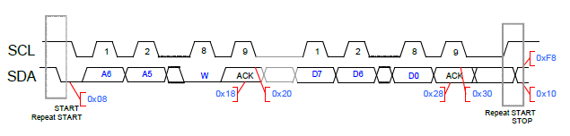
I2C 状态寄存器
26 可能的状态码.
每个I2C 状态码对应一种I2C状态.
  Ex: 发送 START 信号之后, 状态码变为08H.
Notes:
User can know what kind of I2C state was occurred.
Data sheet has detailed description for the 26 status codes.

Slide 15
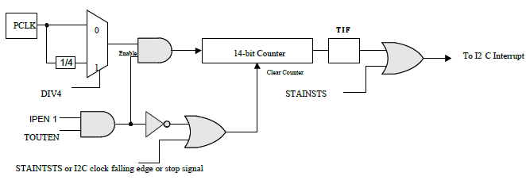
I2C 超时

Slide 16
应用
通过I2C访问 EEPROM.
代码流程如下
  配置NANO系统.
  打开I2C 并设定 I2C 比特率.
  写1个字节到EEPROM的指定地址.
  从EEPROM指定地址将数据读回并比较结果.
Notes:
We will show a sample code how to access EEPROM by using I2C0.

Slide 17
I2C – EEPROM (24LC64)
PA8
PA9
SDA
SCL
I2C
NANO LB
I2C-EEPROM
(24LC64)

Slide 18
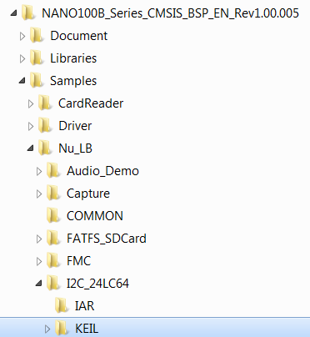
运行 “Smpl_24LC64”

Slide 19
I2C 代码
/*----------------------------------------------------------------------------
MAIN function
----------------------------------------------------------------------------*/
int main(void)
{
uint32_t i2cdata=0;
/* Set multi function pin for I2C0 */
GCR->PA_H_MFP = GCR->PA_H_MFP & ~(PA8_MFP_MASK|PA9_MFP_MASK) |
PA8_MFP_I2C0_SDA | PA9_MFP_I2C0_SCL;
Write_24LC64(0x00000000, 0x55);
SYS_Delay(10000); //delay for finish writting
i2cdata= Read_24LC64(0x00000000);
if(i2cdata != 0x55)
printf("EEPROM Read/Write Test fail!\n");
else
printf("EEPROM Read/Write Test pass!\n");
}
Notes:
Before accessing EEPROM, we need to configure I2C0 I/O pins
And, to open I2C0 controller and set I2C0 bit rate in master mode.
The bit rate is 100Kbps in the example.

Slide 20
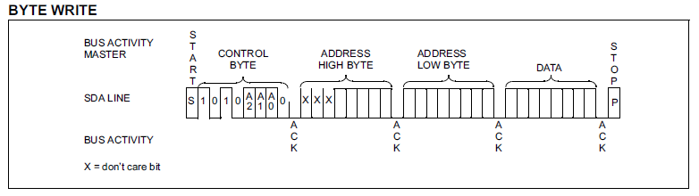
I2C 代码
void Write_24LC64(uint32_t address,uint8_t data )
{
SystemCoreClock = SYS_GetHCLKFreq();
I2C_Init(I2C0);
I2C_Open(I2C0, 100000);
//send i2c start
I2C_Ctrl(I2C0, 1, 0, 0); //set start
I2C_Trig(I2C0);
while(I2C_GetIntFlag(I2C0) == 0);
I2C_ClearIntFlag(I2C0);
//send writer command
I2C0->DATA = 0xA0;
I2C_Trig(I2C0);
while(I2C_GetIntFlag(I2C0) == 0);
I2C_ClearIntFlag(I2C0);
//send address high
I2C0->DATA = (address>>8)&0xFF;
I2C_Ctrl(I2C0, 0, 0, 1);
I2C_Trig(I2C0);
while(I2C_GetIntFlag(I2C0) == 0);
I2C_ClearIntFlag(I2C0);
Notes:
This is the write operation of EEPROM.
The flow is similar to the last example for usage of I2C control register. In data transfer, it includes two bytes address and one byte data.
We will use I2C driver to implement this operation.
We follow the write operation to send start, slave address, address high byte, address low byte, data, and stop in sequence.

Slide 21
I2C代码
//send address low
I2C0->DATA = address&0xFF;
I2C_Ctrl(I2C0, 0, 0, 1);
I2C_Trig(I2C0);
while(I2C_GetIntFlag(I2C0) == 0);
I2C_ClearIntFlag(I2C0);
//send data
I2C0->DATA = data;
I2C_Ctrl(I2C0, 0, 0, 1);
I2C_Trig(I2C0);
while(I2C_GetIntFlag(I2C0) == 0);
I2C_ClearIntFlag(I2C0);
//send i2c stop
I2C_Ctrl(I2C0, 0, 1, 0); //send stop
I2C_Trig(I2C0);
SYS_Delay(100);
I2C_Close(I2C0);
}
Notes:
Here, the data 0x55 will be store in EEPROM.

Slide 22
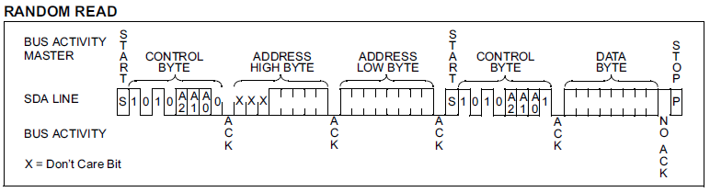
I2C代码(5/6)
uint8_t Read_24LC64(uint32_t address)
{
uint8_t TEMP;
SystemCoreClock = SYS_GetHCLKFreq();
I2C_Init(I2C0);
I2C_Open(I2C0, 100000);
//send i2c start
I2C_Ctrl(I2C0, 1, 0, 0); //set start
I2C_Trig(I2C0);
while(I2C_GetIntFlag(I2C0) == 0);
I2C_ClearIntFlag(I2C0);
//send writer command
I2C0->DATA = 0XA0;
I2C_Trig(I2C0);
while(I2C_GetIntFlag(I2C0) == 0);
I2C_ClearIntFlag(I2C0);
//send address high
I2C0->DATA = (address>>8)&0xFF;
I2C_Ctrl(I2C0, 0, 0, 1);
I2C_Trig(I2C0);
while(I2C_GetIntFlag(I2C0) == 0);
I2C_ClearIntFlag(I2C0);
//send address low
I2C0->DATA = address&0xFF;
I2C_Ctrl(I2C0, 0, 0, 1);
I2C_Trig(I2C0);
while(I2C_GetIntFlag(I2C0) == 0);
I2C_ClearIntFlag(I2C0);
Notes:
This is the read operation of EEPROM.
The first four steps are the same with the Write operation.

Slide 23
I2C代码(6/6)
//send start flag
I2C_Ctrl(I2C0, 1, 0, 0);
I2C_Trig(I2C0);
while(I2C_GetIntFlag(I2C0) == 0);
I2C_ClearIntFlag(I2C0);
//send read command
I2C0->DATA = 0xA1;
I2C_Ctrl(I2C0, 0, 0, 1);
I2C_Trig(I2C0);
while(I2C_GetIntFlag(I2C0) == 0);
I2C_ClearIntFlag(I2C0);
//resive data
I2C0->DATA = 0xFF;
I2C_Trig(I2C0);
while(I2C_GetIntFlag(I2C0) == 0);
TEMP= I2C0->DATA;
//send i2c stop
I2C_Ctrl(I2C0, 0, 1, 0);
I2C_Trig(I2C0);
SYS_Delay(100);
I2C_Close(I2C0);
return TEMP;
}
Notes:
We send the repeated START and slave address with read bit.
Then, we can get data from EEPROM and return a NACK.
At last, we send the STOP signal to end this operation.

