Slide 1
NuMicro Nano100
Touch Key
NuMicro@nuvoton.com

Slide 2
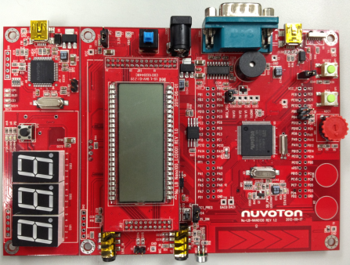
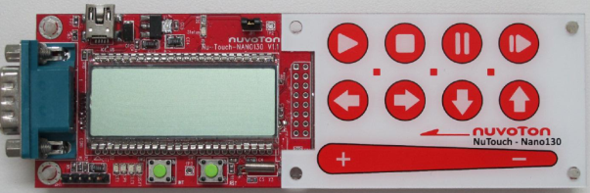
内容
特性
TK 方块图
按键扫描
TK 的寄存器
TK 灵敏度调整
TK 范例& 工具介绍
测试工具 (Nu-LB-Nano130 or NuTouch)

Slide 3
特性
最多支持 16 个触摸按键
解析度可调(16, 14, 12, 10-bit)
灵敏度可调
  调整充电电流
  改变时钟源频率
每个通道时钟除频器可编程
支持周期 (Timer0) 或者软件触发扫描
  最多一次可以扫描 8 个按键
Notes:
Programmable charge current for sensitivity adjustment > for each channel

Slide 4
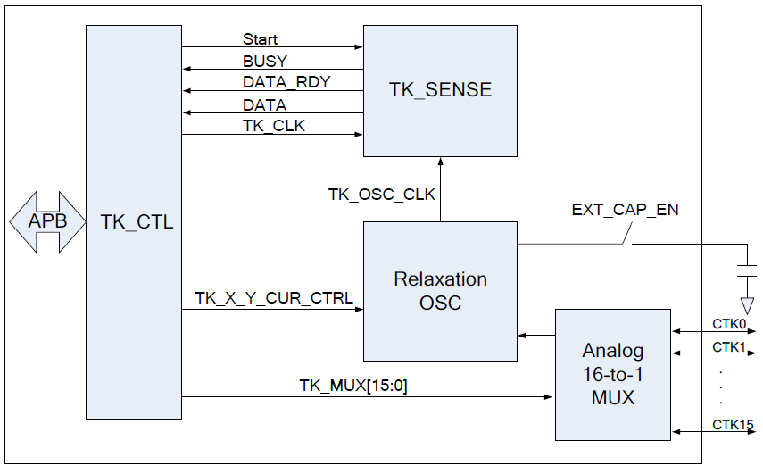
方块图
Notes:
Programmable charge current for sensitivity adjustment > for each channel
弛張振盪感測方式基本上是使用量測充電時間的方法來做檢測。其中充電速率是由固定電流源的值和感測器電容值來做決定。較大的感測器電容器會需要有較長的充電時間,這一部份會運用到脈衝寬度調變器(PWM)與計時器來進行量測。假如我們用手指或觸控筆接觸到觸控開關,就會改變電容器的介電常數,充電放電週期時間就會變長 所以,我們測量週期的變化,就可以偵測到觸控按鍵是否有動作。
由於馳張振盪這類的設計就是靠 RC 的常數來判斷,所以手指的之間的容量很小,當 RC 常數大到某一程度時,則 R 必需要增加,而其結果往往會造成觸控部位的阻抗增加,變成比較會受到噪訊干擾影響。

Slide 5
Key Scan
Data
Data
Overflow
Overflow
Difference
Base
Time
Time
Finger off
Finger on
Timer
RC counter

Slide 6
启动触摸按键扫描
每次最多扫描8 个通道
  通道 (0, 8) (1, 9) … (7, 15) 是互斥的
如果 START_SCAN_BY_TIMER_EN = 0，软件可以写 START_SCAN_BY_MANU=1 来启动扫描
如果 START_SCAN_BY_TIMER_EN = 1，Timer 0 可以触发扫描
  系统power down时，Timer可以触发TK扫描
如果TK正在扫描，触发事件会被丢弃

Slide 7
中断
扫描完成中断
扫描失败中断
门限中断
  扫描结果值小于门限
  扫描结果值大于门限

Slide 8
寄存器
Register | Offset | R/W | Description | Reset Value
TK Base Address: TK_BA = 0x400C_0000
TK_CTL1 | TK_BA+0x00 | R/W | Touch Key Control Register 1 | 0x0000_0000
TK_CTL2 | TK_BA+0x04 | R/W | Touch Key Control Register 2 | 0x4040_4040
TK_CTL3 | TK_BA+0x08 | R/W | Touch Key Control Register 3 | 0x4040_4040
TK_STAT | TK_BA+0x0C | R | Touch Key Status Register | 0x0000_0000
TK_DATA1 | TK_BA+0x10 | R | Touch Key Data Register 1 | 0x0000_0000
TK_DATA2 | TK_BA+0x14 | R | Touch Key Data Register 2 | 0x0000_0000
TK_DATA3 | TK_BA+0x18 | R | Touch Key Data Register 3 | 0x0000_0000
TK_DATA4 | TK_BA+0x1C | R | Touch Key Data Register 4 | 0x0000_0000
TK_INTEN | TK_BA+0x20 | R/W | Touch Key Interrupt Enable Register | 0x0000_0000
TK8_0_THC | TK_BA+0x24 | R/W | TK8/TK0 Threshold Control Register | 0x0000_0000
TK9_1_THC | TK_BA+0x28 | R/W | TK9/TK1 Threshold Control Register | 0x0000_0000
TK10_2_THC | TK_BA+0x2C | R/W | TK10/TK2 Threshold Control Register | 0x0000_0000
TK11_3_THC | TK_BA+0x30 | R/W | TK11/TK3 Threshold Control Register | 0x0000_0000
TK12_4_THC | TK_BA+0x34 | R/W | TK12/TK4 Threshold Control Register | 0x0000_0000
TK13_5_THC | TK_BA+0x38 | R/W | TK13/TK5 Threshold Control Register | 0x0000_0000
TK14_6_THC | TK_BA+0x3C | R/W | TK14/TK6 Threshold Control Register | 0x0000_0000
TK15_7_THC | TK_BA+0x40 | R/W | TK15/TK7 Threshold Control Register | 0x0000_0000

Slide 9
寄存器 – (1)
Register | Offset | R/W | Description | Reset Value
TK_CTL1 | TK_BA+0x00 | R/W | Touch Key Control Register 1 | 0x0000_0000
31 | 30 | 29 | 28 | 27 | 26 | 25 | 24
TK_EN | TK_SEN_SEL | Reserved |  |  |  |  | Reserved
23 | 22 | 21 | 20 | 19 | 18 | 17 | 16
Reserved |  |  |  |  |  | START_ SCAN _BY_ TIMER_EN | START_ SCAN_BY_MANU
15 | 14 | 13 | 12 | 11 | 10 | 9 | 8
EN_TK15_7 | EN_TK14_6 | EN_TK13_5 | EN_TK12_4 | EN_TK11_3 | EN_TK10_2 | EN_TK9_1 | EN_TK8_0
7 | 6 | 5 | 4 | 3 | 2 | 1 | 0
SEL_TK15_7 | SEL_TK14_6 | SEL_TK13_5 | SEL_TK12_4 | SEL_TK11_3 | SEL_TK10_2 | SEL_TK9_1 | SEL_TK8_0
Adjust
Depth (Data Valid bits)

Slide 10
寄存器 – (2)
Register | Offset | R/W | Description | Reset Value
TK_CTL2 | TK_BA+0x04 | R/W | Touch Key Control Register 2 | 0x4040_4040
31 | 30 | 29 | 28 | 27 | 26 | 25 | 24
TK11_3_CUR_CTRL |  |  |  | TK11_3_TBCLK_DIV
23 | 22 | 21 | 20 | 19 | 18 | 17 | 16
TK10_2_CUR_CTRL |  |  |  | TK10_2_TBCLK_DIV
15 | 14 | 13 | 12 | 11 | 10 | 9 | 8
TK9_1_CUR_CTRL |  |  |  | TK9_1_TBCLK_DIV
7 | 6 | 5 | 4 | 3 | 2 | 1 | 0
TK8_0_CUR_CTRL |  |  |  | TK8_0_TBCLK_DIV
调整
充/放电电流
调整
时钟频率

Slide 11
寄存器 – (3)
Register | Offset | R/W | Description | Reset Value
TK_STAT | TK_BA+0x0C | R | Touch Key Status Register | 0x0000_0000
31 | 30 | 29 | 28 | 27 | 26 | 25 | 24
Reserved
23 | 22 | 21 | 20 | 19 | 18 | 17 | 16
TK15_7_THC_ST | TK14_6_THC_ST | TK13_5_THC_ST | TK12_4_THC_ST | TK11_3_THC_ST | TK10_2_THC_ST | TK9_1_THC_ST | TK8_0_THC_ST
15 | 14 | 13 | 12 | 11 | 10 | 9 | 8
TK15_7_SEN_FAIL | TK14_6_SEN_FAIL | TK13_5_SEN_FAIL | TK12_4_SEN_FAIL | TK11_3_SEN_FAIL | TK10_2_SEN_FAIL | TK9_1_SEN_FAIL | TK8_0_SEN_FAIL
7 | 6 | 5 | 4 | 3 | 2 | 1 | 0
SEN_MATCH_LEVEL |  |  |  | Reserved |  | TK_SCAN_CMPLT | TK_BUSY
不推荐使用: 0,1,E,F
扫描是否完成?
0 = Complete or Stop
1= Proceeding

Slide 12
寄存器 – (4)
Register | Offset | R/W | Description | Reset Value
TK_INTEN | TK_BA+0x20 | R/W | Touch Key Interrupt Enable Register | 0x0000_0000
31 | 30 | 29 | 28 | 27 | 26 | 25 | 24
Reserved
23 | 22 | 21 | 20 | 19 | 18 | 17 | 16
Reserved
15 | 14 | 13 | 12 | 11 | 10 | 9 | 8
Reserved
7 | 6 | 5 | 4 | 3 | 2 | 1 | 0
Reserved |  |  |  |  | TK_SEN_ FAIL_IE | TK_SCAN_ CMPLT_IE | TK_SCAN_ CMPLT_THC_IE
扫描失败
扫描完成（没有门限控制）
扫描完成（有高/低门限控制）

Slide 13
寄存器 – (5)
Register | Offset | R/W | Description | Reset Value
TK8_0_THC | TK_BA+0x24 | R/W | TK8/TK0 门限控制寄存器 | 0x0000_0000
31 | 30 | 29 | 28 | 27 | 26 | 25 | 24
TK8_0_HIGH_THC[15:8]
23 | 22 | 21 | 20 | 19 | 18 | 17 | 16
TK8_0_HIGH_THC[7:0]
15 | 14 | 13 | 12 | 11 | 10 | 9 | 8
TK8_0_LOW_THC[15:8]
7 | 6 | 5 | 4 | 3 | 2 | 1 | 0
TK8_0_LOW_THC [7:0]
如果TK8_0_DATA 寄存器中的值大于TK8_0_HIGH_THC中的值，中断将发生
如果TK8_0_DATA 寄存器中的值大于TK8_0_LOW_THC中的值，中断将发生

Slide 14
灵敏度调整
计数器深度(TK解析度)
  增加深度可以提高灵敏度，但是扫描要花更多的时间.
充电电流
  充电电流↑ (↓)→ Base level ↓ (↑)
Time-Base Clock Frequency
一旦“扫描失败”，应该怎么办呢?
降低时钟频率
增加充电电流？？？？
Check TK_STAT [SEN_MATCH_LEVEL] value !!!

Slide 15
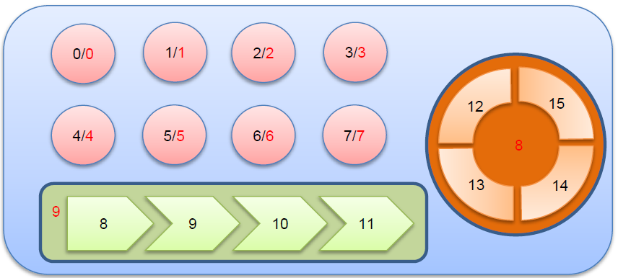
LIBTK
由3种TK按键组成： key, slider, and rotor.
  Slider 和rotor 由4~16 touch key channels组成
  A key 由1 channel组成
最多支持16 个组件
slider and rotor的解析度可配置

Slide 16
库 (Config.c)
libtk_channel_config_s cfg[TK_CH_NUM] =
{
{0x0000, 0x0000, 1, 0},
{0x0000, 0x0000, 1, 0},
{0x0000, 0x0000, 1, 0},
{0x0000, 0x0000, 1, 0},
{0x0000, 0x0000, 1, 0},
{0x0000, 0x0000, 1, 0},
{0x965f, 0x0d69, 7, 3},
{0x949e, 0x13d3, 7, 3},
{0x0000, 0x0000, 1, 0},
{0x0000, 0x0000, 1, 0},
{0x0000, 0x0000, 1, 0},
{0xabd3, 0x0cf5, 7, 3},
{0xa7c8, 0x0e62, 7, 3},
{0xa49d, 0x0c8b, 7, 3},
{0xa590, 0x0dd5, 7, 3},
{0xa86f, 0x0d02, 7, 3}
};
即使一些通道不用，假的值也 必须 给.
Base, diff, current, div

Slide 17
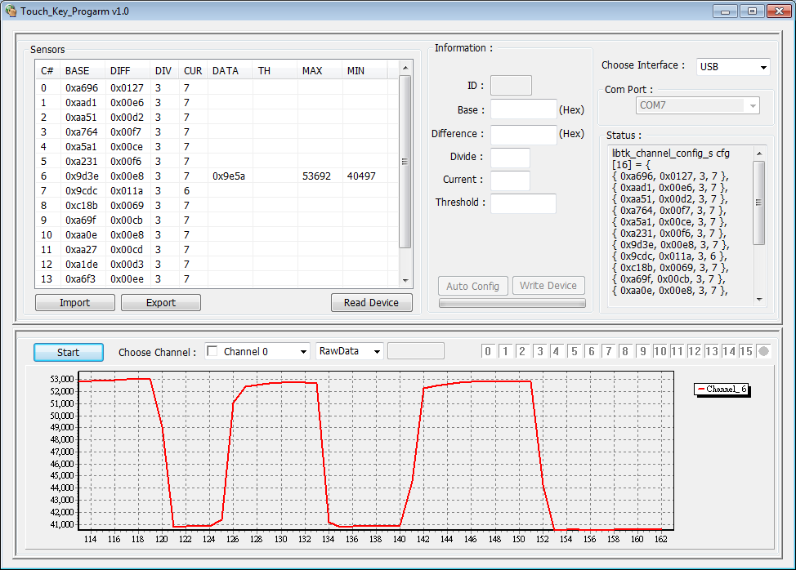
Touch Key AP
Current Status
Settings
Interface Selection
Configuration
Start
Real-Time Data

Slide 18
触摸按键软件工具
下载“TKAP_UART” or “TKAP_USB” to Nu-LB-Nano130 or NuTouch
安装“NuvoTon-TK-Driver.msi”
执行“Touch_Key_Progarm.exe” 并选择正确的接口(USB,UART)
按“Read Device” 取得板子上每个通道的当前状态
选择想要配置的通道，然后按 “Start” 开始监控每个通道的实时数据

Slide 19
Step 1. 下载“TK_USB” 代码
NANO100BSeriesBSP_CMSIS_V1.00.005
Document
NuMicro NANO100B
Driver Reference Guide
Sample
NuTouch
TK_APP
Firmware
TKAP_USB
KEIL
TKAP_USB.uvproj

Slide 20


Step 2. 安装驱动
NANO100BSeriesBSP_CMSIS_V1.00.005
Document
NuMicro NANO100B
Driver Reference Guide
Sample
NuTouch
TK_APP
Windows_APP
application
Touch_Key_Program.exe
Binary
driver
NuvoTon-TK-Driver.msi

Slide 21
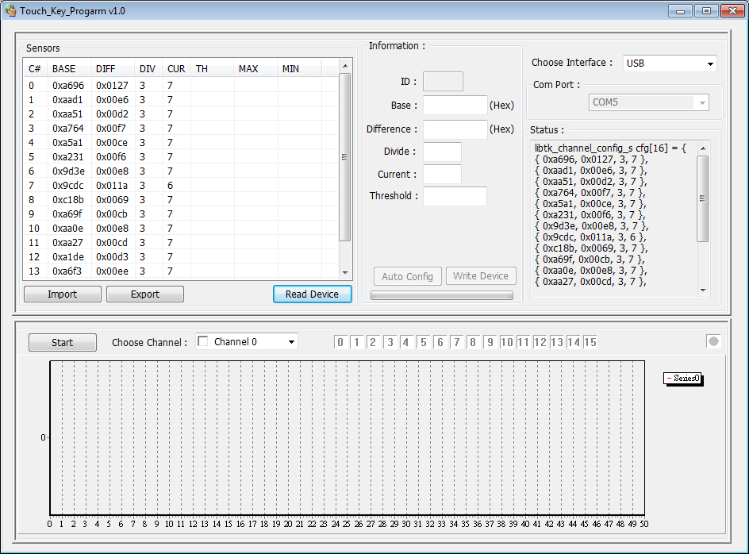
Step 3 & 4. TK 工具
Current Status
Select USB
Read Device

Slide 22
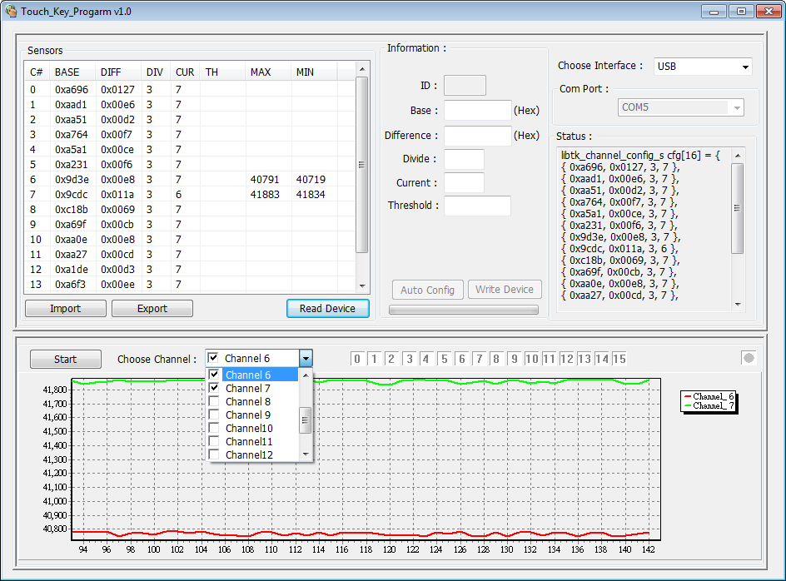
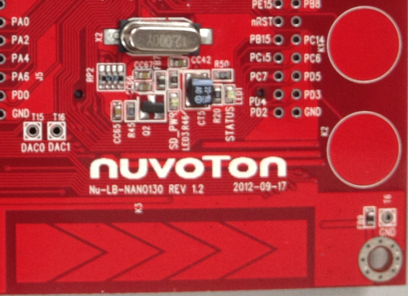
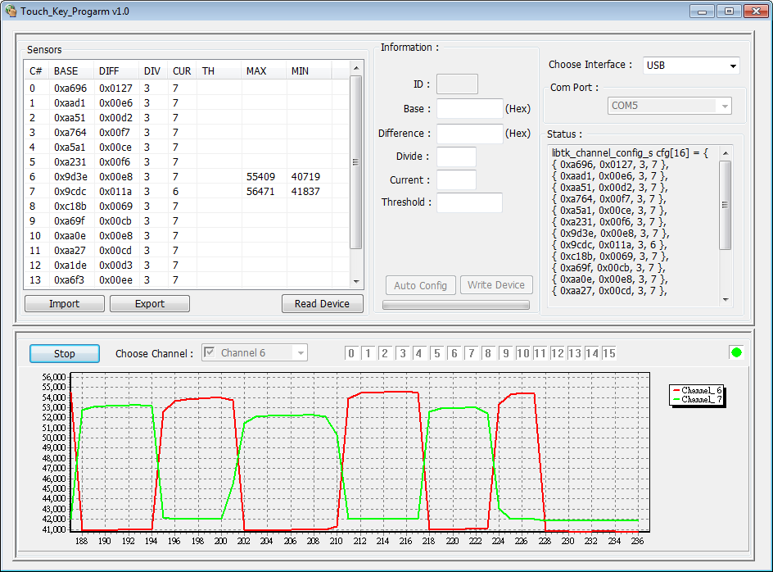
Step 5. 实时监控数据
Channel 7
Channel 6
Channel 15 ………… Channel 11
Finger on
Channel 6 or Channel 7

Slide 23
通过TK_AP自动配置触摸按键
选中某个通道，双击开始监控信息
点击“Auto Config”
保持手指离开通道 #那个
将手指放到通道 #
通道# 配置成功
写设备

Slide 24
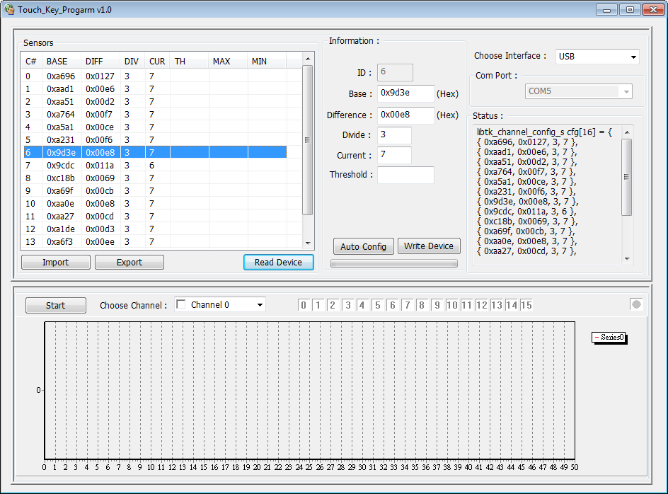
Step 1. 选择通道6
Channel 6
Data
Double Click Channel 6

Slide 25
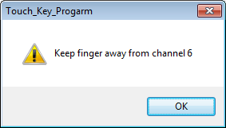
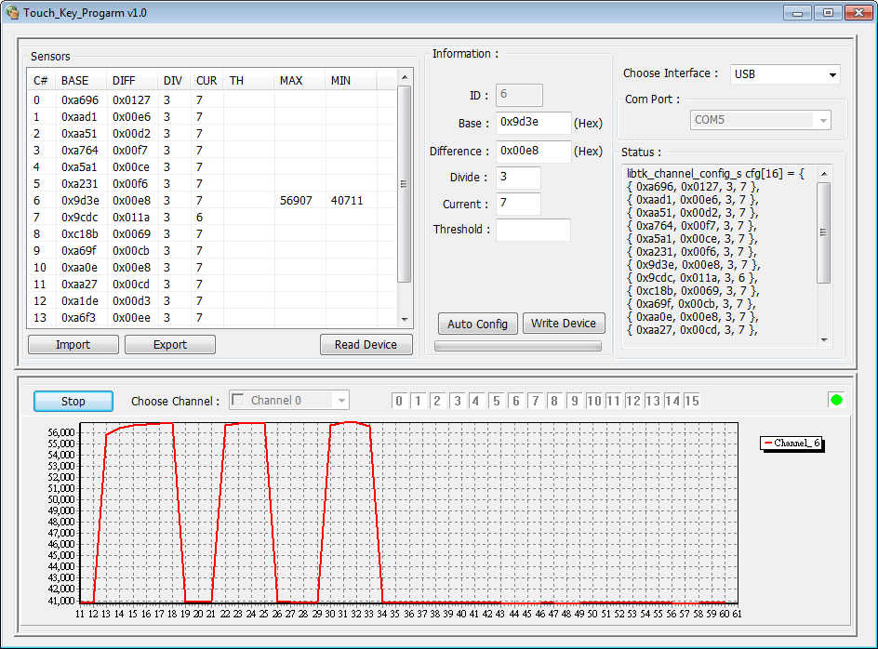
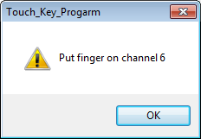
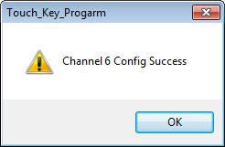
Step 2,3,4 & 5. 自动配置
Press
Auto Config

Slide 26
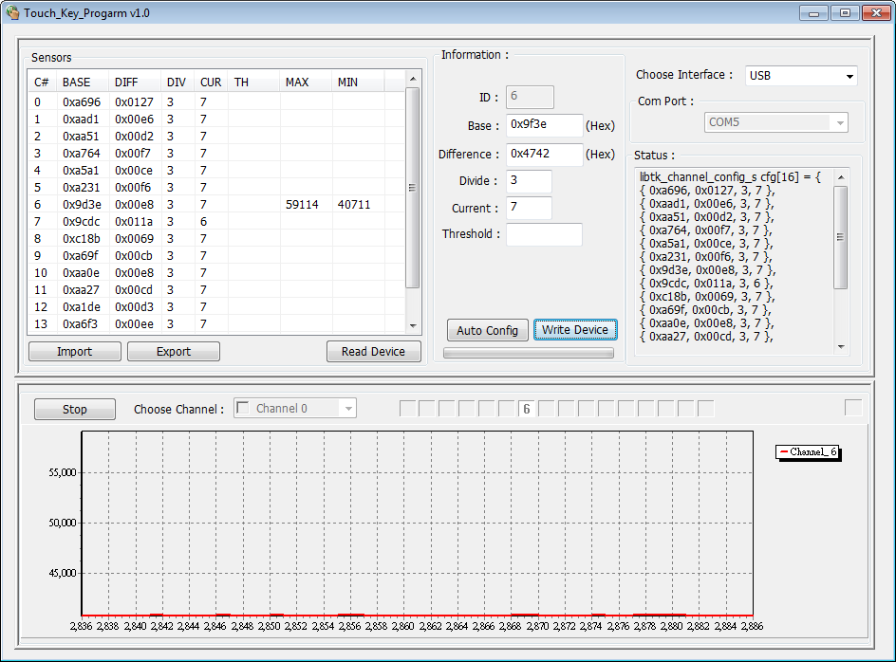
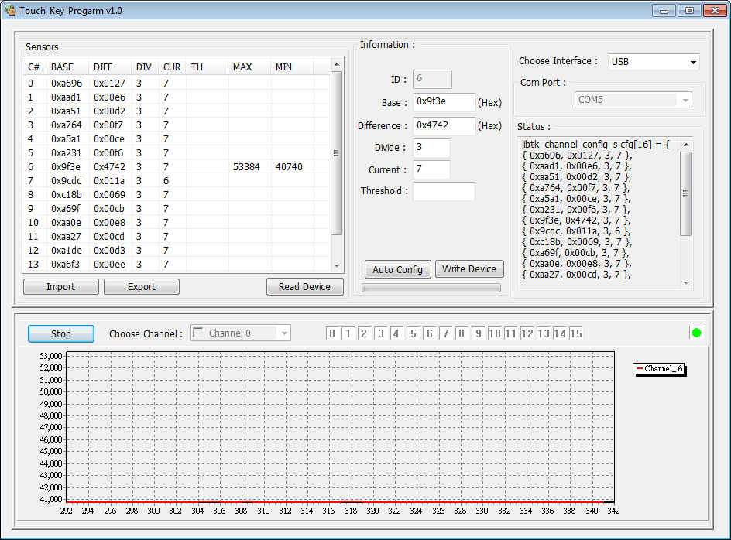
Step 6. 写入设备
Before
After
Channel | BASE | DIFF | DIV | CUR
6 | 0x9d3e | 0x00e8 | 3 | 7
Channel | BASE | DIFF | DIV | CUR
6 | 0x9f3e | 0x3fb1 | 3 | 7

Slide 27
Q & A

