Slide 1
Nano100 ADC & DAC
NuMicro@nuvoton.com

Slide 2
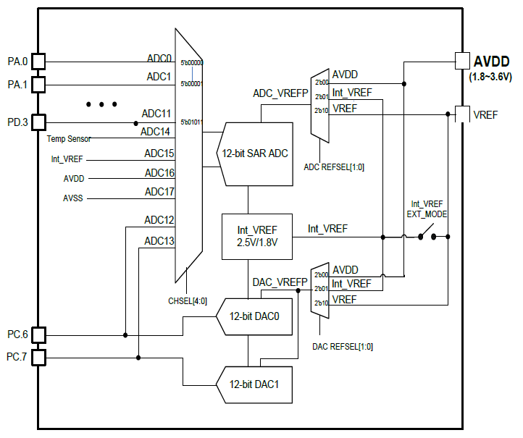
ADC & DAC 方块图
12-bit SAR ADC
2 组12-bit DACs
AVDD = VDD
AVref = 1.8v ~ AVDD
  AVDD
  Int_VREF (1.8v or 2.5v)
  Ext_VREF

Slide 3
特性
12-bit SAR ADC
解析度 12, 10, 8 和6 bits 可选
最高2MHz 转换速度@ 42MHz
最多 12 个外部模拟输入通道
6 个内部模拟输入
  2 DAC 通道
  AVDD 和AVSS
  Internal Vref
  温度传感器

Slide 4
特性
3种操作模式
  单通道
  单次循环
  连续循环
2种输入模式:
  单端
  差分
触发方法
  软件
  外部触发(GPB8)
  带PDMA的定时器事件

Slide 5
特性
支持2种power down 模式
支持2个定时器
支持采样时间可调
支持校正功能

Slide 6
时钟源
最大ADC 时钟频率 42MHz
ADC 时钟频率=
(ADC clock source frequency) / (ADC_N+1);
  ADC_N is an 8-bit pre-scaler

Slide 7
ADC 方块图
3.配置ADC控制寄存器
5. 转换结果
4. 触发 ADC ：
Software Trigger
Timer Trigger
External Trigger Pin (GPB8)
6. ADC PDMA Request
5. ADC 中断发生
1. 选择参考电压
2. 选择通道
Notes:
There are a couple of control registers for ADC related configurations. Such as software trigger bit, channel select bits, calibration control bit and so on.
Each ADC channel has a data register to store its conversion result.
User can transfer the conversion result by PDMA.
ADC interrupt request. It can be issued by result monitor function or an ADC operation.
There are eight analog input channel. The channel 7 has multiple input sources. It can be determined by the setting value of PRESEL.
Reference voltage. User can feed reference voltage via this VREF pin.
External trigger pin. The trigger source can be edge-trigger or level-trigger.

Slide 8
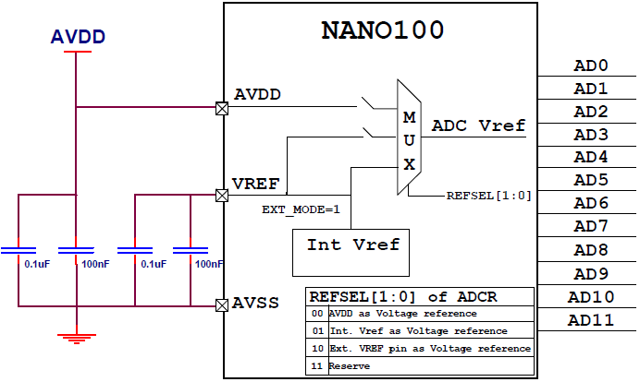
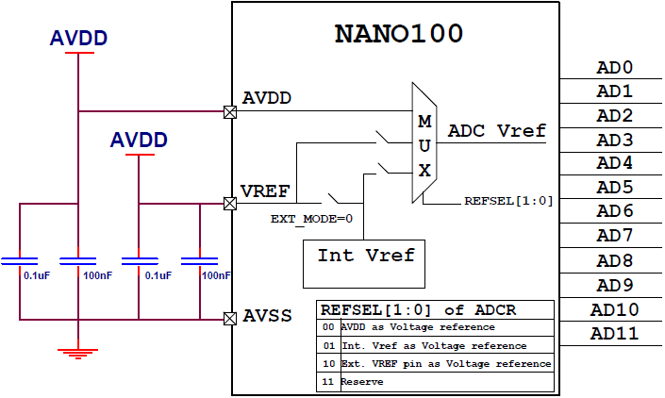
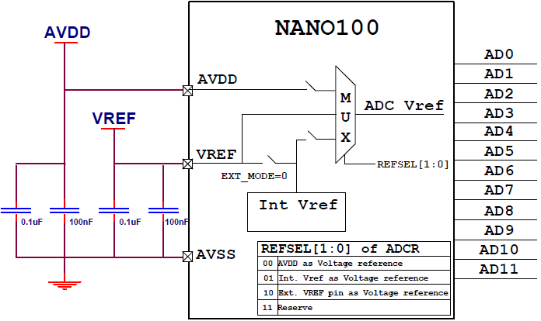
参考电压
3种参考电压可选:
  AVDD
  Internal Vref
  External Vref
Notes:
For example, the differential input channel 0 is the pair of single-end channel 0 and channel 1.

Slide 9
ADC 输入通道设定
ADC 输入脚和PA0~PA7 以及PD0~PD3共享
ADC 输入脚必须关闭digital input
单端输入模式
  通道0 ~ 通道7 和PA0~PA7共享
  通道8 ~ 通道11 和PD0~PD3共享
差分输入模式
  通道0 ~通道5
  差分输入每个通道使用两个输入脚
Differential input paired channel | Single-end input channel
0 | 0 | 1
: | : | :
5 | 10 | 11
Notes:
For example, the differential input channel 0 is the pair of single-end channel 0 and channel 1.

Slide 10
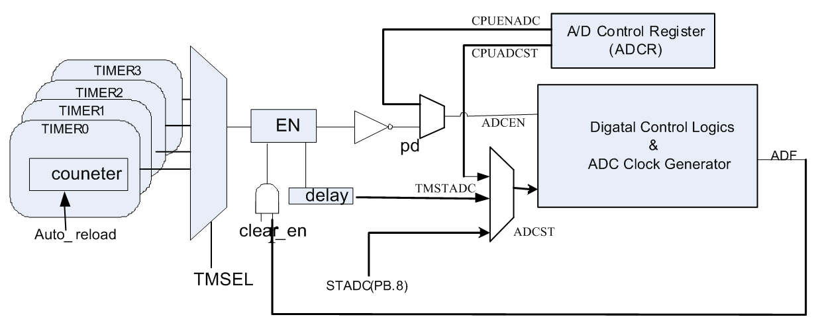
触发 ADC 转换
软件触发
外部事件触发(GPB8)
带PDMA的定时器触发

Slide 11
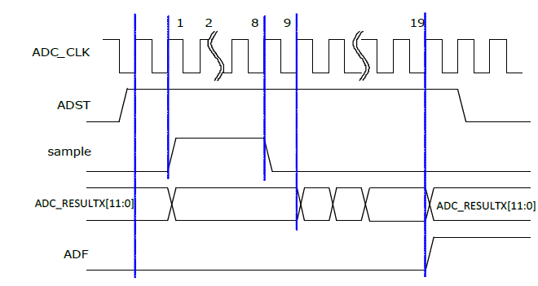
单通道模式
  A/D 转换只在指定的通道执行一次.
  单通道模式下，如果软件在寄存器ADCHER[17:0]中使能多于一个通道，最低的通道号被转换，其它使能的通道被
Channel0

Slide 12
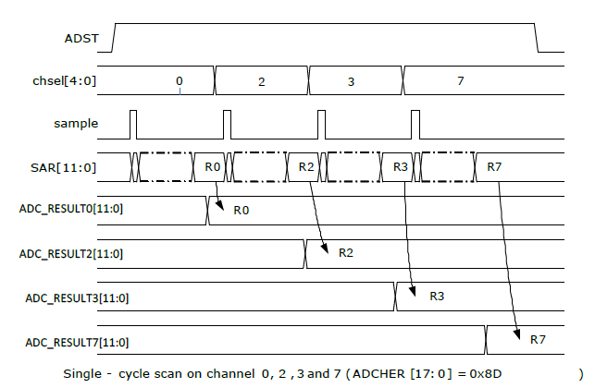
单次循环模式
Channel0
Channel2
Channel3
Channel7

Slide 13
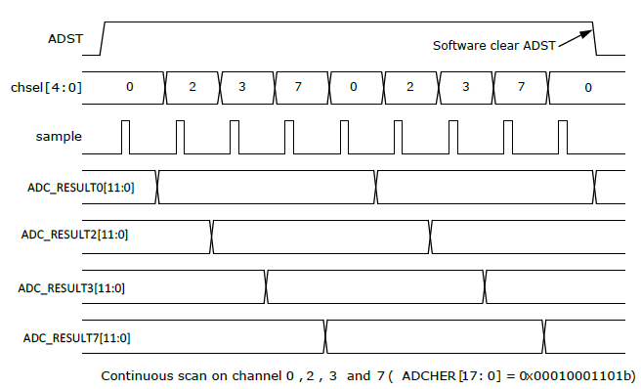
连续循环模式
Channel0
Channel0

Slide 14
Power Down 模式
支持2中省电模式(ADC_CR_ADEN = 0)
  Power down (~50uS @ 3.3v)
  Standby (~10uS @ 3.3v)
系统复位之后等待 INITRDY = 1
ADC上电之后等待 PWUPRDY = 1
Stable time
Power consumption

Slide 15
校正
支持2种校正模式
  Use built-in calibration block (81 ADC clocks)
  Manually load calibration word (1 ADC clocks)
支持ADC上电之后自动校正

Slide 16
采样时间
额外的采样时间和保持时间(0~1024)
  所有外部通道可以单独配置采样时间
  内部通道(包括两个DAC channels) 共享同一个采样配置时间
2种类型的输入通道
  通道0 ~ 5 are fast input channels
  通道6 ~ 17 are slow input channels

Slide 17
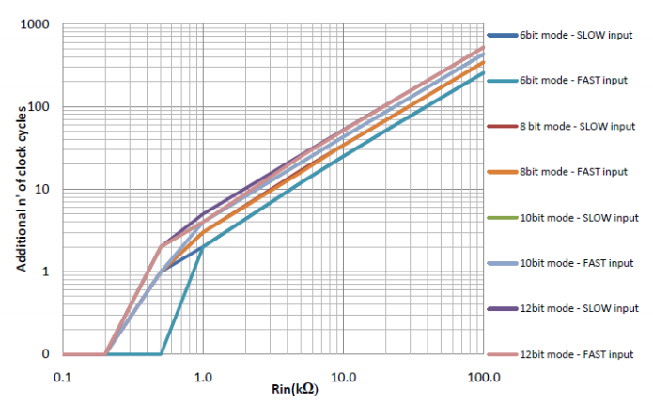
采样时间
chxsmpcnt | ADC clock
0 | 0
1 | 1
2 | 2
3 | 4
4 | 8
5 | 16
6 | 32
7 | 64
8 | 128
9 | 256
10 | 512
11 | 1024
12 | 1024
13 | 1024
14 | 1024
15 | 1024
Typical condition AVDD=3.3V CLK=42MHz

Slide 18
数字比较器
2 个数字比较器.
某个ADC通道的转换结果可以和用户指定的比较条件CMPD(ADCCMPRx[27:16])比较
指定通道的转换完成之后，比较行为将自动开始.
Notes:
The compare data is a user-defined value in CMPD setting.
User can select any channel to be the compare channel. When the conversion of the channel is completed, the compare action will be triggered automatically.
User can decide the compare condition by setting CMPCOND and CMPMATCNT.
The match counter is a internal counter. It counts the number of the conversion result which matched the compare condition. As the match counter equals to the setting value of CMPMATCNT add 1, the CMPFx will be set to 1. A compare interrupt will be asserted if the interrupt is enabled.

Slide 19
ADC 中断
3种中断源
  ADF: ADC 转换完成
  CMPF0: ADC 比较器0比较条件满足
  CMPF1: ADC 比较器1比较条件满足
Notes:
ADF will be set to 1, when a ADC operation mode finished its conversion.
CMPF0 and CMPF1 are the flags of result monitor function. If the conversion result reach the compare condition, these flag will be set to 1.
As one of the flags is set to 1 and its corresponding interrupt is enabled, the ADC interrupt will be asserted.

Slide 20
代码
uint16_t u16data;
uint8_t gu8AdcIntFlag = 0;
void ADC_IRQHandler ()
{
ADC->SR = 0x01;//Clear ADC flag
gu8AdcIntFlag = 1 ;//Set software flag
}
int main(void)
{
/* Set GPA0 for ADC0 */
GPIOA->OFFD |= GPIO_OFFD_OFFD_0;//Disable digital input path
GCR->PA_L_MFP = (GCR->PA_L_MFP & ~PA0_MFP_MASK)|PA0_MFP_ADC_CH0;
/* Set Single end, Single mode and AVDD for reference voltage */
ADC_Init(ADC_CR_SINGLE_END, ADC_CR_ADMD_SINGEL,0x01, ADC_CR_REFSEL_AVDD);
ADC_EnableInt() ;//Enable ADC interrupt
ADC_POWER_ON;//Turn on ADC power
ADC_START_CONV ;//Start conversion
while(gu8AdcIntFlag==0) ;// Wait for setting software flag
ADC_DisableInt() ;//Disable ADC interrupt
u16data = ADC_GetConversionData(0) ;//Get ADC result
}

Slide 21
DAC特性
支持2个12-bit DAC通道
支持组模式 (同步更新)
触发
  软件
  定时器
  PDMA

Slide 22
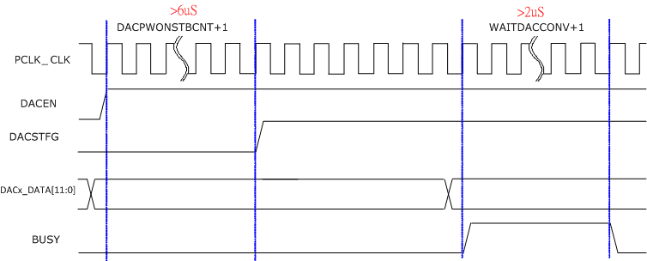
时序
上电稳定事件: 6 us
  DACPWONSTBCNT (14 bit)
转换完成时间: 2 us (500k sample/sec)
  WAITDACCONV (8 bit)

Slide 23
DAC 触发模式
软件触发
  写DACx_DATA 寄存器
PDMA 触发
  Delay time : (WAITDACCONV+1)/PCLK
定时器触发
  超时事件或者捕获事件

Slide 24
DAC 输出波形
Software Trigger
Timer/PDMA Trigger

Slide 25
组模式
2 个DAC通道同步更新
Channel 0 决定触发模式
如果数据更新没有使用PDMA, 在下一个转换开始之前，软件必须更新两个 DACx_DAT 寄存器

Slide 26
中断

Slide 27
代码
void DAC_IRQHandler(void)
{
if(DAC->STS0 & DAC_STS_IFG) {
DAC->DATA0++; //Increase value of output data
DAC_CLEAR_CH0_INTERRUPT; //Clear DAC interrupt
}
}
const uint8_t us = ((PCLK) / 1000000);
int32_t main (void)
{
uint16_t i;
GCR->PC_L_MFP = (GCR->PC_L_MFP & ~PC6_MFP_MASK) | PC6_MFP_DA_OUT0; // Set GPC6 for DAC0
TIMER_Init(TIMER0, 11, 1000, TIMER_CTL_MODESEL_PERIODIC);//Set periodic mode and 1000 tick/second
/* Enable triggger event for DAC.*/
TIMER_ConfigTriggerEvent(TIMER0, TIMER_CTL_DACTEEN, TIMER_CTL_TIMEOUTTRGEN);
DAC_Init(); //Initiate DAC
DAC_SetRefVol(DAC_COMCTL_REFSEL_AVDD); //Set AVDD for reference voltage
DAC_SetDelayTime(0, us * 6, us * 2); //Initiate delay time
DAC_SetLoadSel(0, DAC_CTL_LSEL_TIMER0_CH0); //Set trigger source from timer 0
DAC_CH0_POWER_ON; //Turn on DAC power
while(DAC_GetState(0) != DAC_IDLE); // Wait for power stable
DAC_EnableInterrupt(0); //Enable interrupt
while(1);
}

Slide 28
Q & A

