Slide 1
NuMicro Nano
Smart Card
NuMicro@nuvoton.com

Slide 2
特性
ISO 7816-3 compliant
EMV2000 compliant
Support up to 3 interfaces
Programmable transmission clock frequency
Programmable receiver buffer trigger level
Programmable guard time
Support one 24-bit and two 8-bit counters for ATR and wait time processing
Support auto convention

Slide 3
特性
Configurable clock stop function
Configurable Tx/Rx error retry count
Support hardware activation/ warm reset/ deactivation sequence
Support auto deactivation if card removal detected
Support UART mode
  Programmable baud rate for each channel
  Configurable Rx FIFO trigger level
  Support EVEN, ODD, and no parity bit
  Support 1 or 2 stop bit

Slide 4
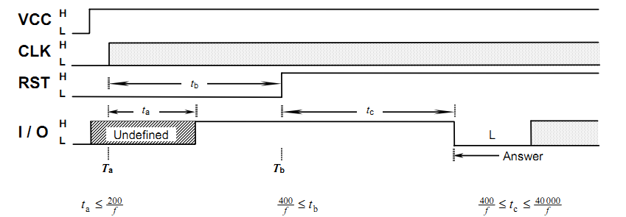
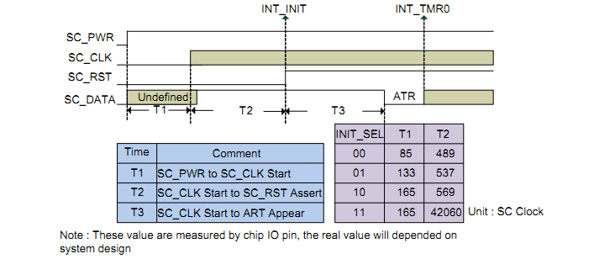
Activation

Slide 5
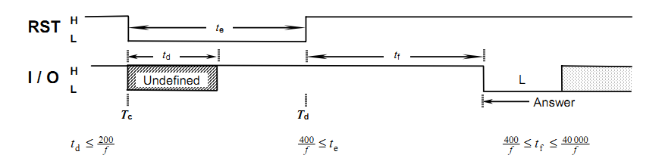
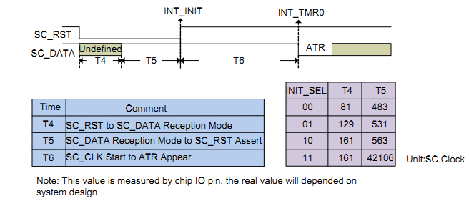
Warm Reset

Slide 6
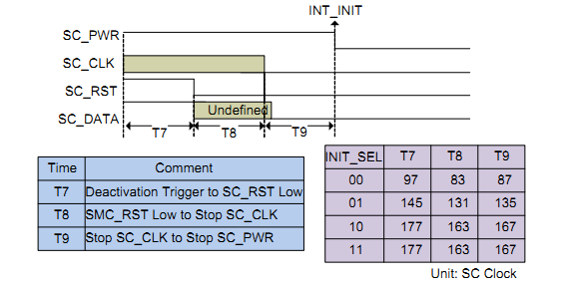
Deactivation

Slide 7
Elementary Time Unit (ETU)
1 etu = (F/D) * (1/f)
  F: clock rate conversion integer
  D: baud rate adjustment integer
Default etu is 372 clock cycles

Slide 8
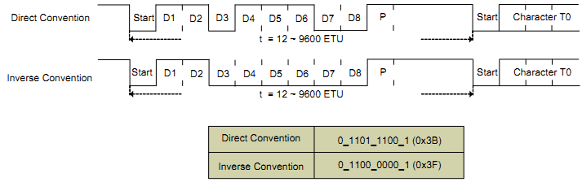
Smartcard 数据格式

Slide 9
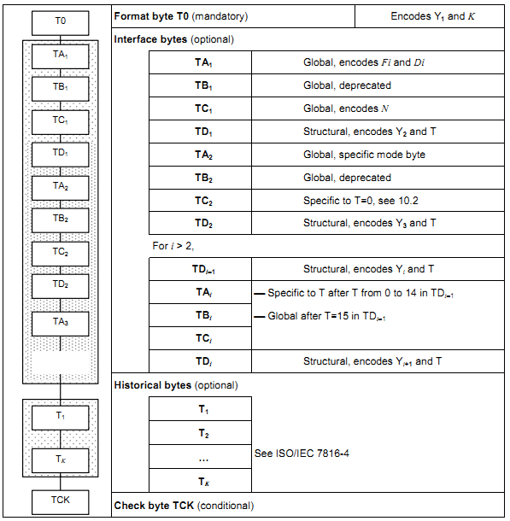
Answer to Reset (ATR)

Slide 10
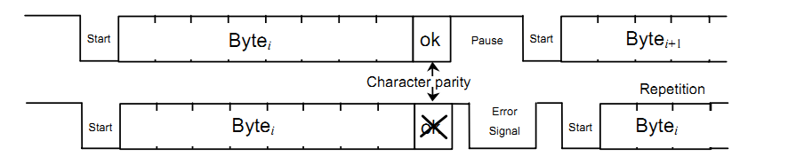
错误信号和字符重传

Slide 11
Timer Modes
0: Starts when enabled and ends when time out
1: Starts when first START bit (ether Tx or Rx) detected and ends when time out
2: Starts when first Rx START bit detected and ends when time out
3: Starts when RST L->H and ends when ATR received or time out (Timer 0 only)
4: Similar to 0, but recount on START
5: Similar to 1, but recount on START

Slide 12
Timer Modes
6: Similar to 2, but recount on START
7: Start when START detected, reload on every START bit
8: Up counter, enable/disable by software
15: Start/stop by software, reload on START.

Slide 13
代码
int32_t main (void)
{
/* Set USB Clock Divider */
SYS_SetClockDivider_0(CLK_CLKDIV0_USB_MASK, USB_CLK_DIVIDER(1));
/* Select SC Clock Source From 12MHz */
CLK->CLKSEL2 = (CLK->CLKSEL2 & ~CLK_CLKSEL2_SC_MASK) | CLK_CLKSEL2_SC_HXT;
/* Set SC Clock divider which divide by 3 to 4Mhz be used */
CLK->CLKDIV0 = (CLK->CLKDIV0 & ~CLK_CLKDIV0_SC0_MASK) | (2 << 28);
CLK->CLKDIV1 = (CLK->CLKDIV1 & ~CLK_CLKDIV1_SC1_MASK) | 2;
/* Set Muti-function pin Port A as SC0 */
MFP_SC0_TO_PORTA();
/* SmartCard 0 Initialization */
SMARTCARD_Init(SC0, 1);
SMARTCARD_PowerActiveLevel(SC0, 0); // Power pin is active LOW
SMARTCARD_Open(SC0);
/* Execute CCID process */
CCID_MainProcess();
}
NOTE: We don’t release smartcard library source code

Slide 14
Thank you.

