Slide 1
LCD of Nano110
Nuvoton (SH) Ltd.

Slide 2
CONTENTS
LCD Principle
LCD IP of Nano110
  4X40段，或6X38段 (64PIN的是4X31 / 6X29)
  静态, 2-MUX, 3-MUX, 4-MUX, 5-MUX, 6-MUX
  静态, 1/2偏压, 1/3偏压
  内部电荷泵和电阻分压网
  闪烁功能

Slide 3
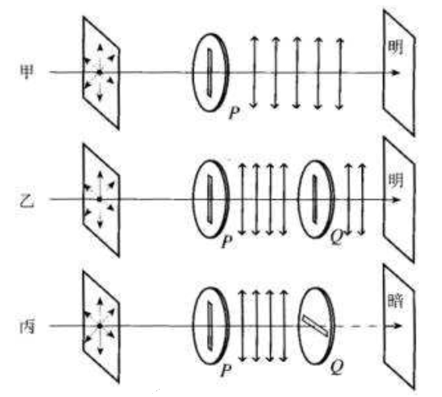
LCD Principle

Slide 4
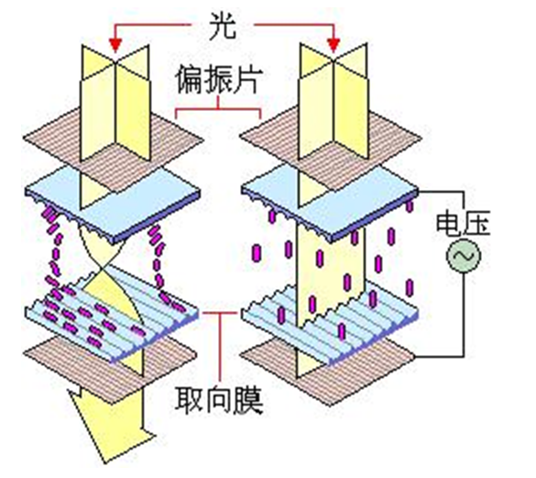
LCD Principle

Slide 5
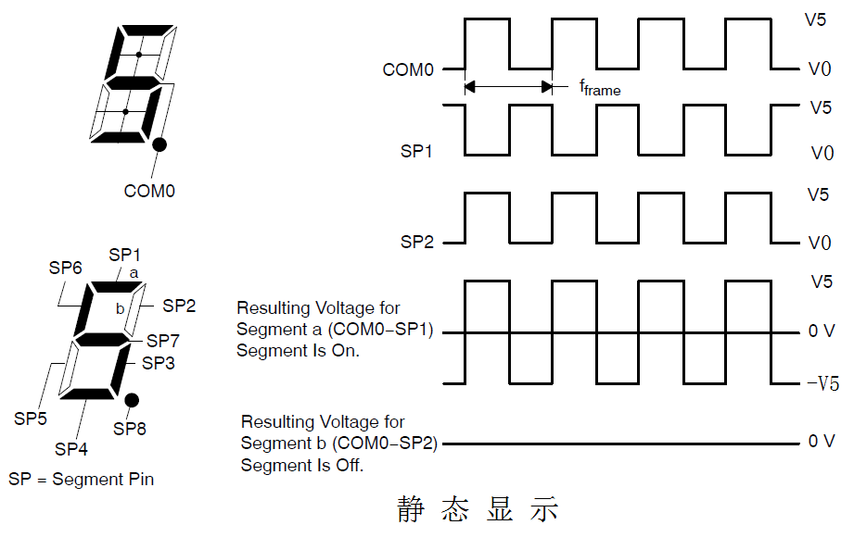
LCD Principle

Slide 6
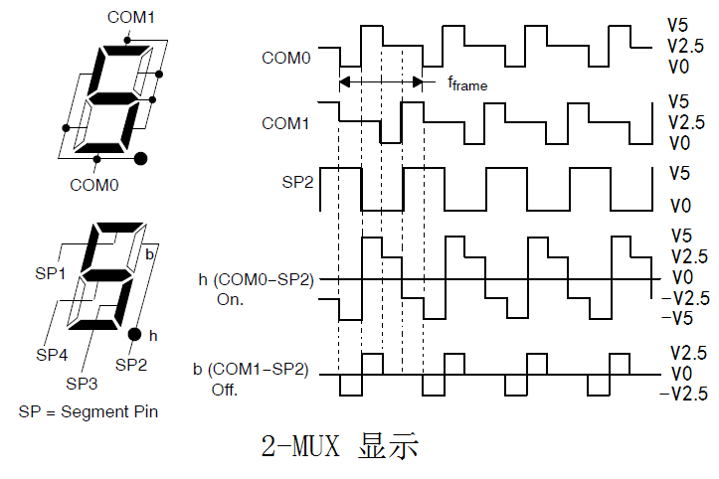
LCD Principle

Slide 7
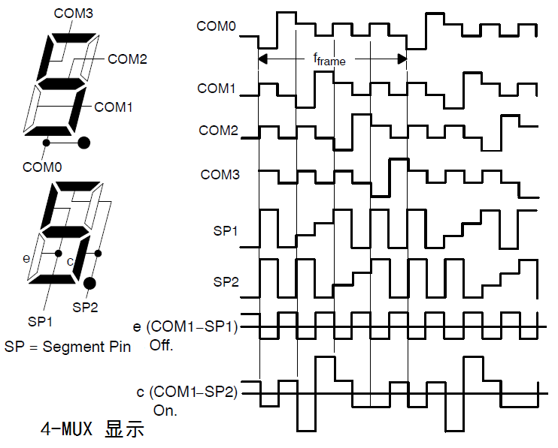
LCD Principle

Slide 8
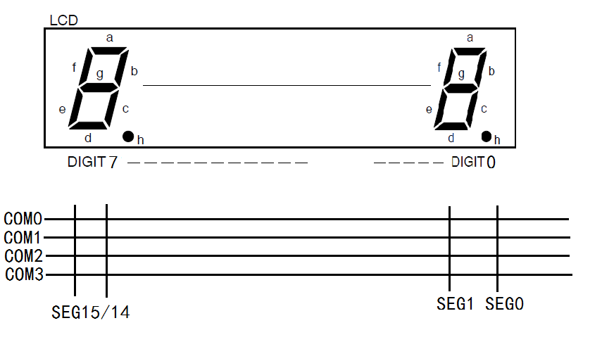
LCD Principle

Slide 9
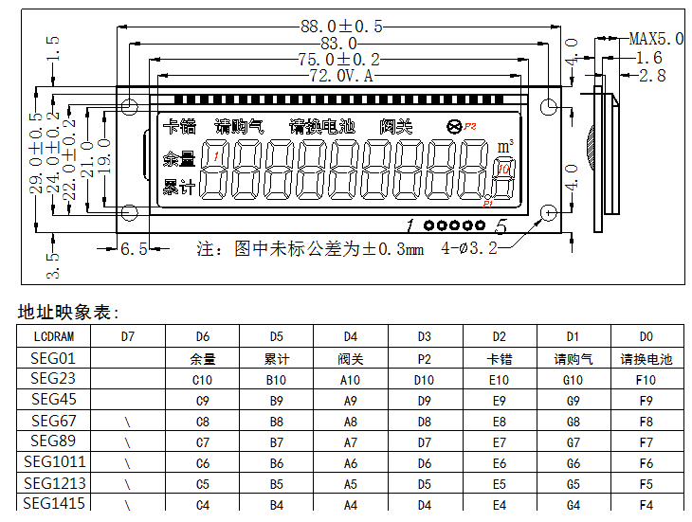
LCD Principle

Slide 10
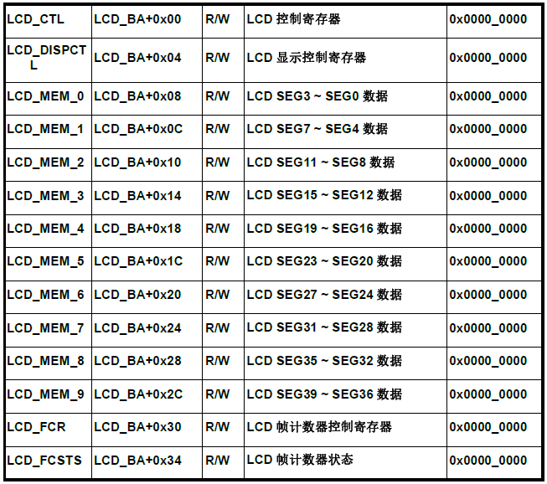
LCD IP of Nano110

Slide 11
LCD IP of Nano110
Void Lcd_Init(void){
}
CLK->CLKSEL1 |= CLK_CLKSEL1_LCD_LIRC ; // 时钟选择10KHz
CLK->APBCLK |= CLK_APBCLK_LCD_EN ; // 时钟使能
LCD->CTL = LCD_CTL_PDDISP_EN // 显示使能
| LCD_FREQ_DIV32 // 时钟 32 分频
| LCD_MUX_ONE_FOURTH // 4-MUX
| LCD_CTL_EN ; // LCD IP 使能
LCD->DISPCTL = LCD_CPUMP_DIV1 //充电泵不分频
| LCD_CPVOl_3V //LCD电压 3V
| LCD_DISPCTL_IBRL_EN //内部电阻分压使能
| LCD_BIAS_THIRD //1/3 偏压
| LCD_DISPCTL_CPUMP_EN ; //充电泵使能
MFP_LCD_TYPEA(); //PIN 配置

Slide 12
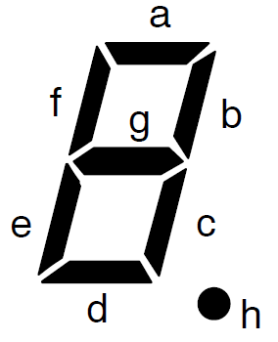
LCD IP of Nano110
#define a 0x80
#define b 0x40
#define c 0x20
#define d 0x01
#define e 0x02
#define f 0x08
#define g 0x04
#define h 0x10
const uint32_t Tab_Lcd[ ] = {
a + b + c + d + e + f , //0
b + c , //1
a + b + d + e + g , //2
a + b + c + d + g , //3
b + c + f + g , //4
a + c + d + f + g , //5
a + c + d + e + f + g , //6
a + b + c , //7
a + b + c + d + e + f + g , //8
a + b + c + d + f + g , //9
d + e + f , //A : L
c + d + e + g , //B : o
g , //C : -
e + g , //D : r
a + d + e + f + g , //E : E
0 , //F : 关显示
}

Slide 13
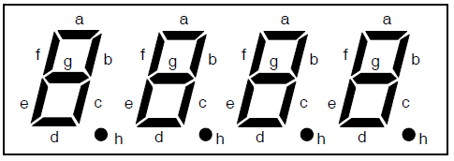
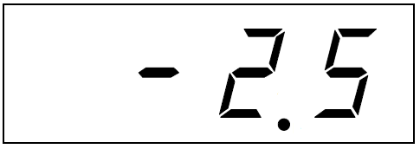
LCD IP of Nano110
LCD->MEM_1 = Tab_Lcd[5] ; //SEG01 显 5
LCD->MEM_2 = Tab_Lcd [2] + h ; //SEG45 显 2.
LCD->MEM_3 = Tab_Lcd [0xC] ; //SEG89 显负号
LCD->MEM_4 = Tab_Lcd [0xF] ; // SEG12/13 不显

Slide 14
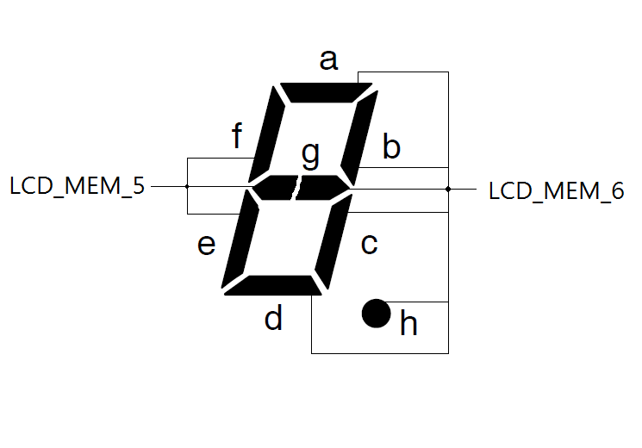
Nutiny_SDK_Nano130
Nutiny_SDK_Nano130板子一个”8”被分到两个LCD_MEM中

Slide 15
Nutiny_SDK_Nano130
LCD->MEM_1 = Tab_Lcd[5] ; //SEG01 显 5
/// 显示”5”变成以几句
LCD_MEM_5 &= ~(e + f + 0x04000000); //清左半边
LCD_MEM_5 |= Tab_Lcd[Data] & (e + f + 0x04000000) ;
LCD_MEM_6 &= ~(a + b + c + d + Lcd_h + 0x200) ; //清右半边
LCD_MEM_6 |= Tab_Lcd[Data] & (a + b + c + d + Lcd_h + 0x200) ;

