Slide 1
NuMicro Nano
Flash 控制器(FMC)
NuMicro@nuvoton.com
Notes:
In the next topic, I will present the Flash Memory Controller

Slide 2
内容
Flash 控制器特性
Flash 映射
Data Flash
FMC 寄存器
ISP 命令
用户配置
启动选择
In System Programming (ISP)
In Application Programming (IAP)
范例

Slide 3
Flash 内存特性
APROM 123/64/32 KB
4KB in system programming 空间(LDROM)
for ISP loader
Data flash 起始地址和大小可以编程
页擦除单位512 bytes
支持PDMA 读 Data Flash

Slide 4
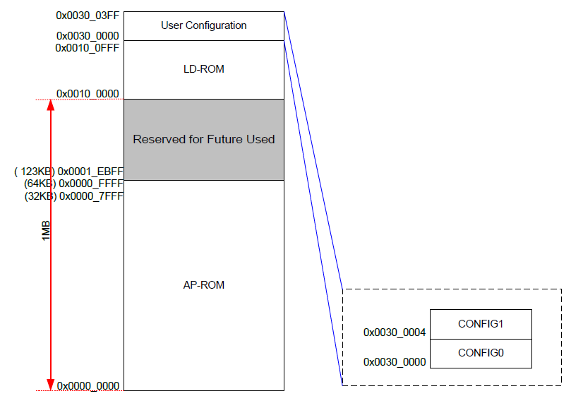
Flash 内存映射

Slide 5
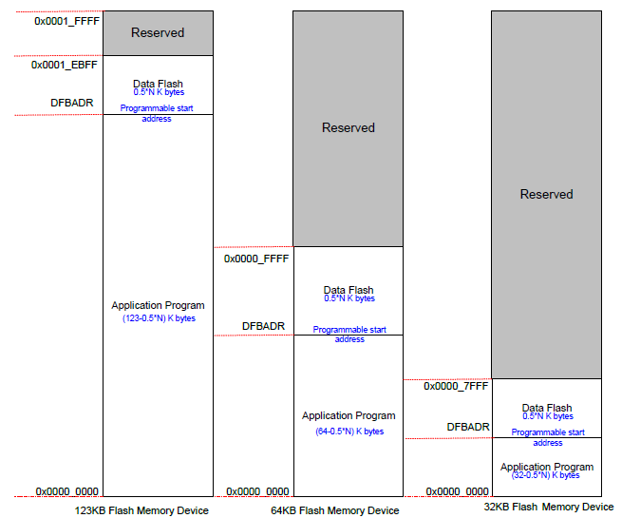
Data Flash

Slide 6
FMC 寄存器
Register | Offset | R/W | Description | Reset Value
Base Address (FMC_BA) : 0x5000_C000
ISPCON | 0x00 | R/W | ISP 控制寄存器 | 0x0000_0000
ISPADR | 0x04 | R/W | ISP 地址寄存器 | 0x0000_0000
ISPDAT | 0x08 | R/W | ISP 数据寄存器 | 0x0000_0000
ISPCMD | 0x0C | R/W | ISP 命令寄存器 | 0x0000_0000
ISPTRG | 0x10 | R/W | ISP 触发寄存器 | 0x0000_0000
DFBADR | 0x14 | R | Data Flash 起始地址 | User Config1
ISPSTA | 0x40 | R/W | ISP 状态寄存器 | 0x0000_0000

Slide 7
ISPCON
Bits | Descriptions
[31:7] | - | Reserved
[6] | ISPFF | ISP Fail Flag
[5] | LDUEN | LDROM Update Enable
[4] | CFGUEN | Enable Config-bits Update by ISP
[3] | APUEN | APROM Update Enable
[2] | - | Reserved
[1] | BS | Boot Select (1:LDROM; 0:APROM)
[0] | ISPEN | ISP Enable

Slide 8
ISPADR
Bits | Descriptions
[31:0] | ISP Address | ISP erase/program/read address
ISPDAT
Bits | Descriptions
[31:0] | ISP Data | ISP program/read data word

Slide 9
ISPCMD
Bits | Descriptions
[31:6] | Reserved
[5] | FOEN
[4] | FCEN
[3:0] | FCTRL
Operation Mode | FOEN | FCEN | FCTRL[3:0]
Read | 0 | 0 | 0x0
Vector Page Remap | 1 | 0 | 0xE
Program | 1 | 0 | 0x1
Page Erase | 1 | 0 | 0x2
Read CID | 0 | 0 | 0xB
Read DID | 0 | 0 | 0xC
Read UID/UCID | 0 | 0 | 0x4

Slide 10
ISPTRG
Bits | Descriptions
[31:1] | Reserved
[0] | ISPGO | ISP start trigger
DFBADR
Bits | Descriptions
[31:0] | DFBA | Data Flash Base Address

Slide 11
ISPSTA
Bits | Descriptions
[31:21] | Reserved
[20:9] | VECMAP | Vector Page Mapping Address
[8:7] | Reserved
[6] | ISPFF | ISP Fail flag
[5:3] | Reserved
[2:1] | CBS | Boot Selection Status
[0] | ISPBUSY | ISP BUSY

Slide 12
ISP 命令
Enable DFEN/LDUEN
If ISPFF(Fail Flag) = 1,
it means the one of the follow conditions.
1. APROM writes to itself.
5 Commamds :
2. LDROM writes to itself.
1. Read
3. CONFIG is erased/programmed when
the MCU is running in APROM if
CFGUEN is set to 0.
2. Program
3. Page Erase
4. Destination address is illegal,
such as over an available range.
4. Read CID
5. Read DID

Slide 13
擦除
int32_t DrvFMC_Erase(uint32_t u32addr)
{
FMC->ISPCMD = 0x22;
FMC->ISPADR = u32addr; /* 512 bytes aligned page address */
FMC->ISPTRG_BITS.ISPGO = 1;
while (FMC->ISPTRG_BITS.ISPGO) ;
if (FMC->ISPCON_BITS.ISPFF == 1) {
FMC->ISPCON_BITS.ISPFF = 1;
return E_DRVFMC_ERR_ISP_FAIL;
}
return 0;
}

Slide 14
编程
int32_t DrvFMC_Write(uint32_t u32addr, uint32_t u32data)
{
FMC->ISPCMD = 0x21;
FMC->ISPADR = u32addr; /* word aligned */
FMC->ISPDAT = u32data;
FMC->ISPTRG_BITS.ISPGO = 1;
while (FMC->ISPTRG_BITS.ISPGO) ;
if (FMC->ISPCON_BITS.ISPFF == 1) {
FMC->ISPCON_BITS.ISPFF = 1;
return E_DRVFMC_ERR_ISP_FAIL;
}
return 0;
}

Slide 15
读
int32_t DrvFMC_Read(uint32_t u32addr, uint32_t *u32data)
{
FMC->ISPCMD = 0x00;
FMC->ISPADR = u32addr; /* word aligned */
FMC->ISPTRG_BITS.ISPGO = 1;
while (FMC->ISPTRG_BITS.ISPGO) ;
if (FMC->ISPCON_BITS.ISPFF == 1) {
FMC->ISPCON_BITS.ISPFF = 1;
return E_DRVFMC_ERR_ISP_FAIL;
}
*u32data = FMC->ISPDAT;
return 0;
}

Slide 16
用户配置区 – Config0
Bits | Descriptions
[31:27] | Reserved | Reserved
[26] | CFOSC | CPU Clock Source Select After Reset 0: External 12MHz crystal clock, 1: Internal RC 12MHz oscillator clock
[25:21] | Reserved | Reserved
[20:19] | CBORST | Brown Out Reset Enable 00: BOD17 reset enable 01: BOD20 reset enable 10: BOD25 reset enable 11: Reserved
[18:8] | Reserved | Reserved

Slide 17
Bits | Descriptions
[7:6] | CBS | Config Boot Selection 11: APROM(LDROM invisible) 01: LDROM(APROM invisible) 10: CPU boot from APROM. 00: CPU boot from LDROM. Memory 0x0000_0000~0x0000_01FF be re-mapped to page 0 of LDROM.
[5:2] | Reserved | Reserved
[1] | LOCK | Security Lock 0 = Flash data is locked 1 = Flash data is not locked. When flash data is locked, only device ID, Config0 and Config1 can be read by writer and ICP thru serial debug interface. Others data is locked as 0xFFFFFFFF. ISP can read data anywhere regardless of LOCK bit value.
[0] | DFEN | Data Flash Enable 0 = Enable data flash 1 = Disable data flash

Slide 18
用户配置区 – Config1
Bits | Descriptions
[31:20] | Reserved | Reserved
[19:0] | DFBA | Data Flash Base Address The data flash base address is defined by user.

Slide 19
启动选择
启动选择由Config0 CBS[1:0]决定.
在Power-On 复位, BOD复位, WDT复位, RTC复位, ... FMC 将加载Config0 CBS[1] to ISPCON->BS bit.
CPU 复位和系统复位, FMC 不会加载Config0 CBS to ISPCON->BS bit.
用户可以通过设定ISPCON->BS bit 并执行 CPU 复位来动态切换启动模式(APROM or LDROM).

Slide 20
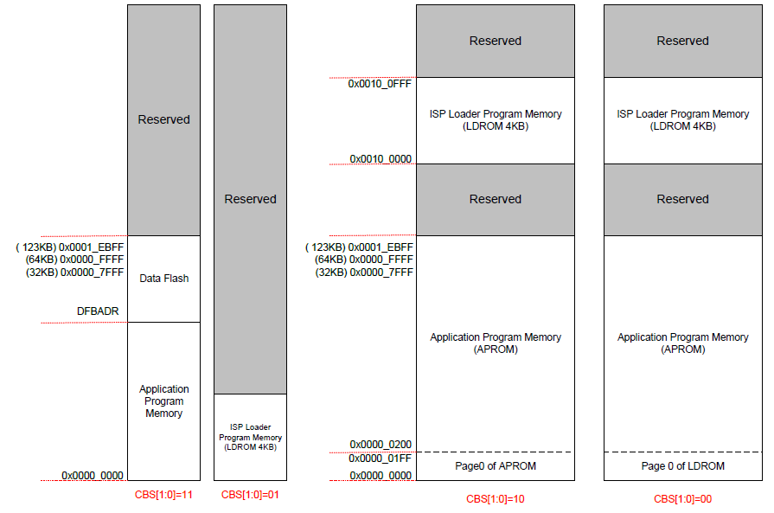
启动模式& 内存映射

Slide 21
In System Programming (ISP)
ISP 的目的是提供一种方法便于更新APROM中的应用程序.
ISP 程序放在LDROM中. 客户程序放在APROM中.
ISP Master (PC or NuMicro board)通过UART/USB/I²C/SPI控制ISP 程序.

Slide 22
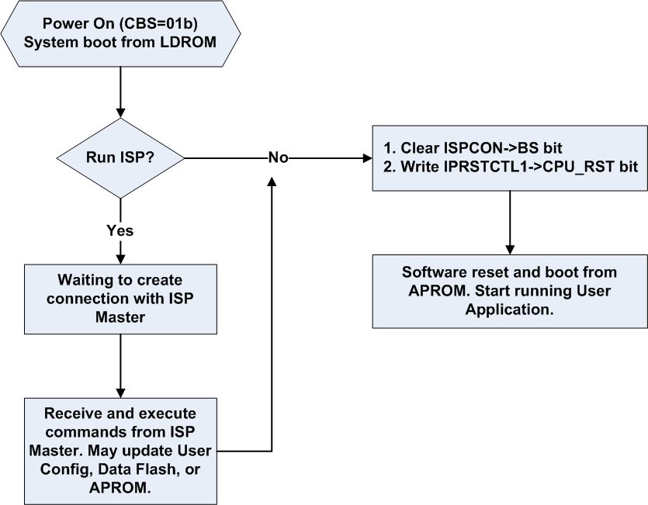
ISP 流程

Slide 23
In Application Programming (IAP)
支持所有的ISP 功能.
可以更新应用程序，不用复位系统
设定CBS=10b or 00b
程序可以在 APROM 和LDROM之间跳转.
没有 data flash. LDROM 和APROM 的任何地方都可以用作data area.

Slide 24
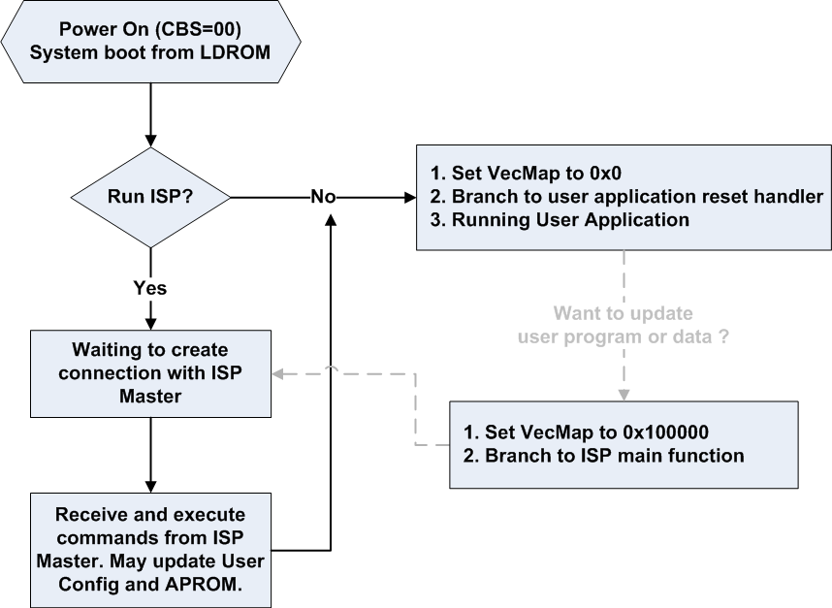
IAP 流程 (CBS=00b)

Slide 25
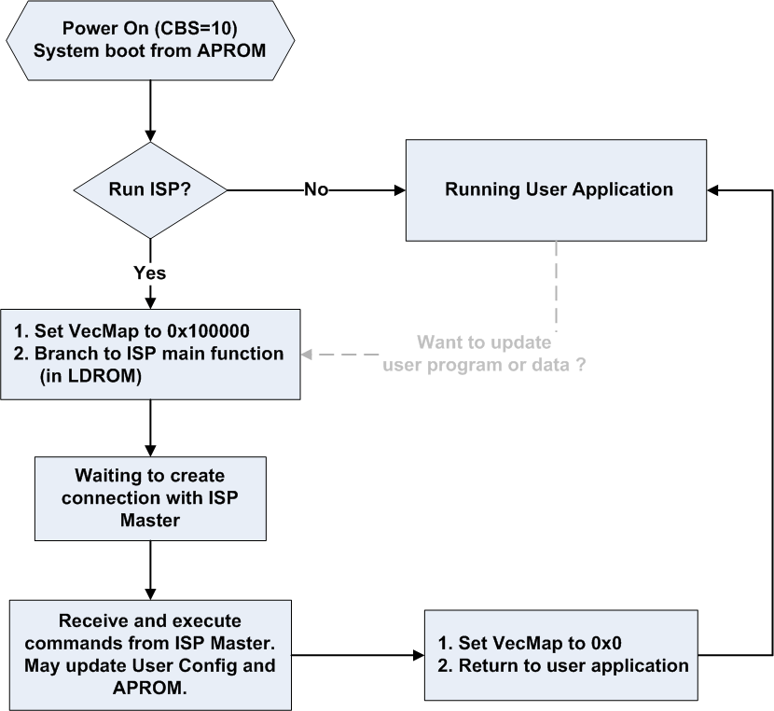
IAP 流程 (CBS=10b)

Slide 26
范例
SMPL_FMC_DEMO
  编译isp and ld_boot firstly
  编译ap_demo.
  写ap_demo.bin to APROM
  运行.

Slide 27
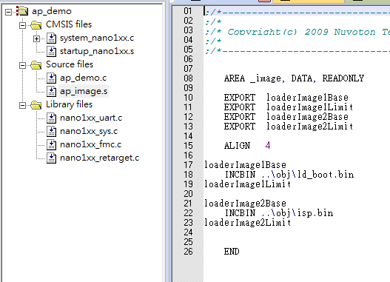
ap_image.s
Include bin file to image

Slide 28
ap_demo.c
/*---------------------------------------------------------------------------------------------------------*/
/* Main Function */
/*---------------------------------------------------------------------------------------------------------*/
int32_t main (void)
{
...
UNLOCKREG();
FMC_Init();
FMC_EnableLDUpdate();
if (load_image_to_flash((uint32_t)&loaderImage1Base, (uint32_t)&loaderImage1Limit, LDROM_BASE, LDROM_SIZE) != 0)
{
printf("Load image to LDROM failed!\n");
return -1;
}
FMC_DisableLDUpdate();
FMC->ISPCON |= FMC_ISPCON_APUEN; // FMC Enable APUpdate
if (load_image_to_flash((uint32_t)&loaderImage2Base, (uint32_t)&loaderImage2Limit, ISP_BASE, ISP_MAX_SIZE) != 0)
{
printf("Load image to APROM failed!\n");
return -1;
}

Slide 29
ap_demo.c(CONT’)
FMC_EnableConfigUpdate();
config0 = (config0 & ~0xc0); /* set CBS to 00b */
FMC_Erase(CONFIG0);
FMC_Write(CONFIG0, config0 | 0x2);
FMC_Write(CONFIG1, config1);
FMC_DisableConfigUpdate();
// do chip reset
GCR->IPRST_CTL1 |= GCR_IPRSTCTL1_CHIP;
}
29

Slide 30
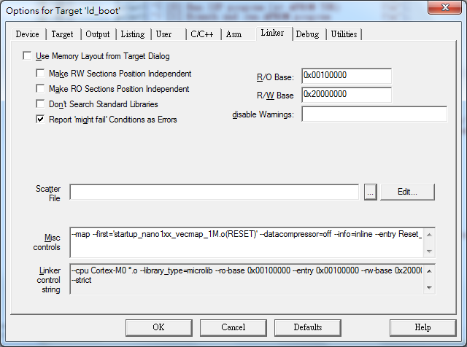
ld_boot 选择

Slide 31
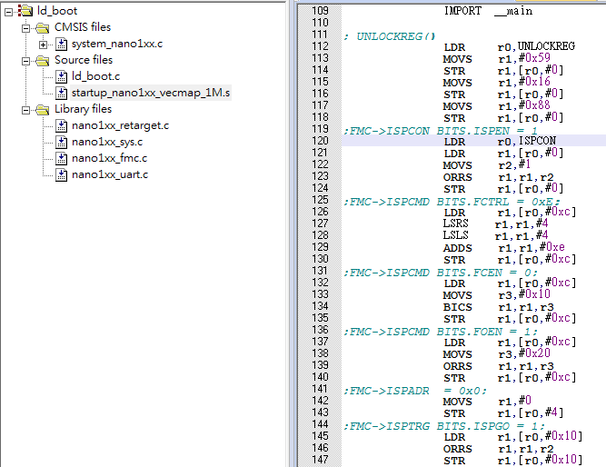
Startup_nano1xx_vecmap_1M.s
Enable Vector Page Remap

Slide 32
ld_boot代码
#define USER_AP_ENTRY (0)
#define ISP_CODE_ENTRY (50*1024)
typedef void (FUNC_PTR)(void);
int32_t main (void)
{
FUNC_PTR *func;
....
func = (FUNC_PTR *)(*(uint32_t *)(ISP_CODE_ENTRY+4));
FMC_SetVectorPage(0x0);
func();
....
func = (FUNC_PTR *)(*(uint32_t *)(USER_AP_ENTRY+4));
FMC_SetVectorPage(0x0);
func();
}
32

Slide 33
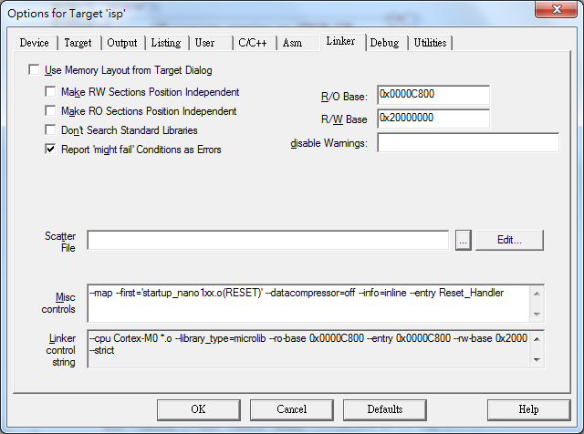
ISP 选项

Slide 34
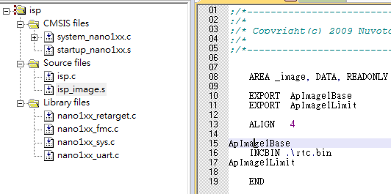
isp_image.s
Include bin file to image

Slide 35
ISP.c
#define USER_AP_MAX_SIZE (50*1024)
#define USER_AP_ENTRY (0)
#define ISP_CODE_ENTRY (50*1024)
#define LD_BOOT_CODE_ENTRY 0x100000
#define PAGE_SIZE 512
typedef void (FUNC_PTR)(void);
int32_t main (void)
{
FUNC_PTR *func;
…
func = (FUNC_PTR *)(*(uint32_t *)(LD_BOOT_CODE_ENTRY+4));
FMC_SetVectorPage(0x100000);
func();
…
func = (FUNC_PTR *)(*(uint32_t *)(USER_AP_ENTRY+4));
FMC_SetVectorPage(0x0);
func();
…
35

Slide 36
ISP.c (CONT’)
FMC->ISPCON |= FMC_ISPCON_APUEN; // FMC_EnableAPUpdate();
if (load_image_to_flash((uint32_t)&ApImage1Base, (uint32_t)&ApImage1Limit,
USER_AP_ENTRY, USER_AP_MAX_SIZE) != 0)
{
printf("Load image to APROM failed!\n");
return -1;
}
FMC->ISPCON &= ~FMC_ISPCON_APUEN; // FMC_DisableAPUpdate();
func = (FUNC_PTR *)(*(uint32_t *)(USER_AP_ENTRY+4));
FMC_SetVectorPage(0x0);
func();
…
}
36

Slide 37
Thank you

