Slide 1
NuMicro Nano
EBI
NuMicro@nuvoton.com

Slide 2
内容
EBI 介绍
EBI 特性
EBI 方块图
16/8 bit EBI 和外设的连接
EBI 时序
范例

Slide 3
EBI 介绍
External bus interface(EBI) to access external device
Interface Signals
  EBI_MCLK
  AD[15:0]
  nCS
  nRD
  nWR
  ALE
Application:
  To connect with external Flash, SRAM, etc.

Slide 4
EBI 特性
External devices with max. 64 Kbytes size (8-bit data width)/128 Kbytes (16-bit data width) supported
Supports variable external bus base clock (MCLK)
Supports 8-bit or 16-bit data width
Supports variable data access time (tACC), address latch enable time (tALE) and address hold time (tAHD)
Address bus and data bus multiplex mode supported to save the address pins
Configurable idle cycle supported for different access condition: Write command finish (W2X), Read-to-Read (R2R), Read-to-Write (R2W)
Supports PDMA and VDMA transfer

Slide 5
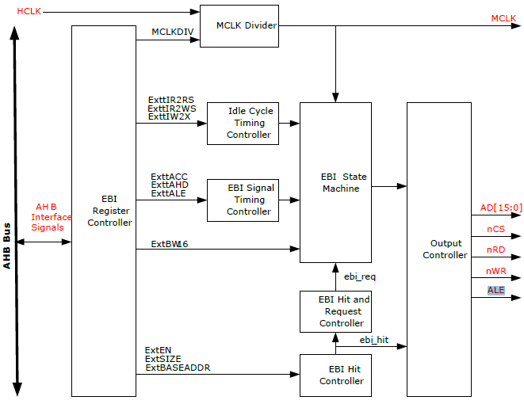
方块图

Slide 6
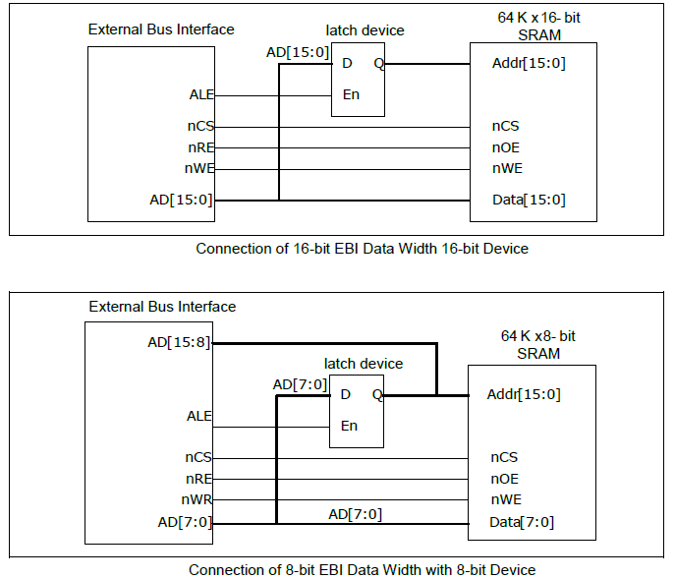
16/8 bit EBI 和外设的连接

Slide 7
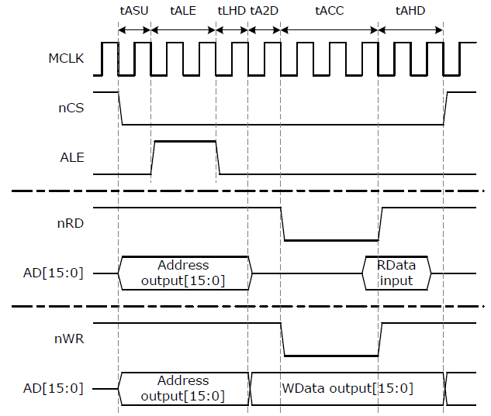
EBI 总线时序: 16 bits

Slide 8
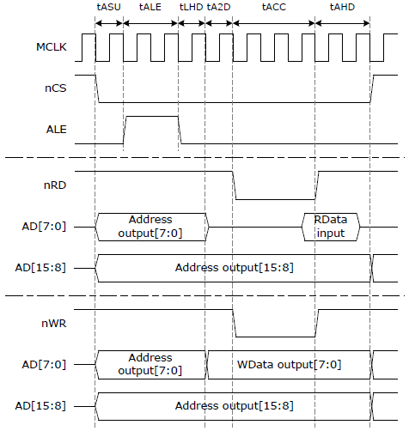
EBI 总线时序: 8 bits

Slide 9
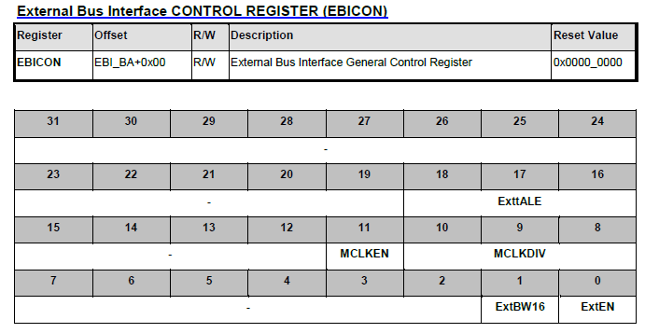
EBI 控制寄存器(1/2)

Slide 10
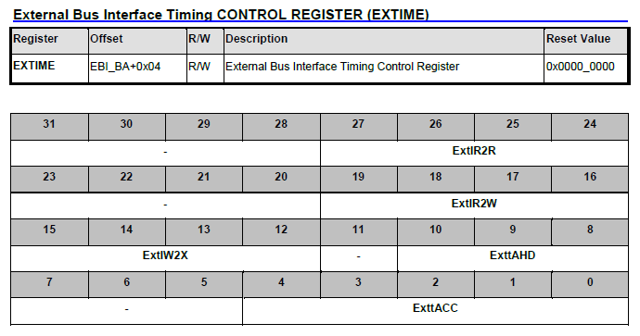
EBI控制寄存器(2/2)

Slide 11
代码
#define EBI_BASE_ADDR 0x60000000 /* 0x60000000 ~ 0x6001FFFF */
uint16_t temp;
// Enable EBI function with 16-bit data width
EBI_Init(0);
// Configure EBI timing
sEBITiming.eMCLKDIV = E_EBI_MCLKDIV_2;
sEBITiming.u8ExttALE = 2;
sEBITiming.u8ExtIR2R = 2;
sEBITiming.u8ExtIR2W = 2;
sEBITiming.u8ExtIW2X = 2;
sEBITiming.u8ExttAHD = 2;
sEBITiming.u8ExttACC = 2;
EBI_SetBusTiming(sEBITiming);
(uint16_t *)EBI_BASE_ADDR=0x01; //write data to EBI_BASE_ADDR
temp= (uint16_t *)EBI_BASE_ADDR; //read data form EBI_BASE_ADDR

Slide 12
Thank you

